Slide 1
ROB-FIN 2020
ROB-FIN Rekisteritutkimus
Rheumatology Register study on antirheumatic and biologic drugs in Finland

Slide 2
STUDY DESIGN
Mandated by scientific committee of the Finnish Society for Rheumatology (Toimeksiantaja: SRYn tieteellinen tmk/tiedonhallintajaos)
Longitudinal observational cohort study/seurantakohorttitutkimus
Inclusion criteria:
  Inflammatory rheumatic disease (M05-M06, M07 (L40.5),M45-M46 & M08+other juvenile arthrites)
  Patient treated within specialized healthcare clinics participating in the data collection
  Both biologic & conventional DMARD users included

Slide 3
DATA COLLECTION
Paper data collection forms (”old ROB-FIN”)
  Dates back to 1999, SRY initiative
  Separate forms for rheumatologist and patients (and for AEs)
  To be completed at each routine care visit
  Biologic drug users only
Hospital electronic patient records
(GoTreatIT (GTI), N=16, BCB Laaturekisteri, N=3)
  In use since 2007 (varies between clinics)
  Increasingly all patients regardless of medication since 2015->

Slide 4
ETHICAL ASPECTS
Ethical permission granted by HUS coordinating ethical board
Main study permission granted by National Institute for Health and Welfare (THL ad 2021)/erillistä suostumusta ei tarvita jos potilas GTI.ssä tai BCB.ssä.
Informed consents from all patients enrolled to the study via paper data collection forms
Uudet anomukset tehty Findatalle:
  Vanhan tutkimuksen jatkoa ajatellen
  Uusi prospektiivinen tutkimus

Slide 5
THL.n vastauskirje Laaturekisteri-ilmoitukseen 24.6.20

Slide 6
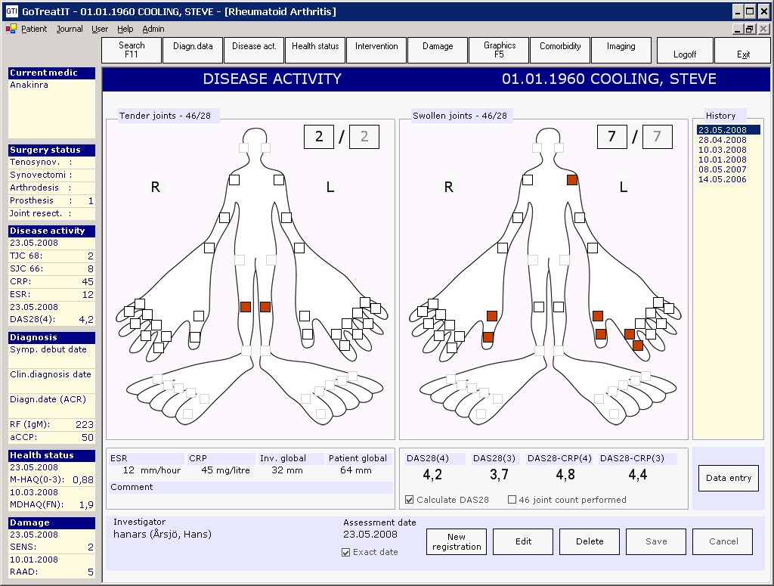

Slide 7
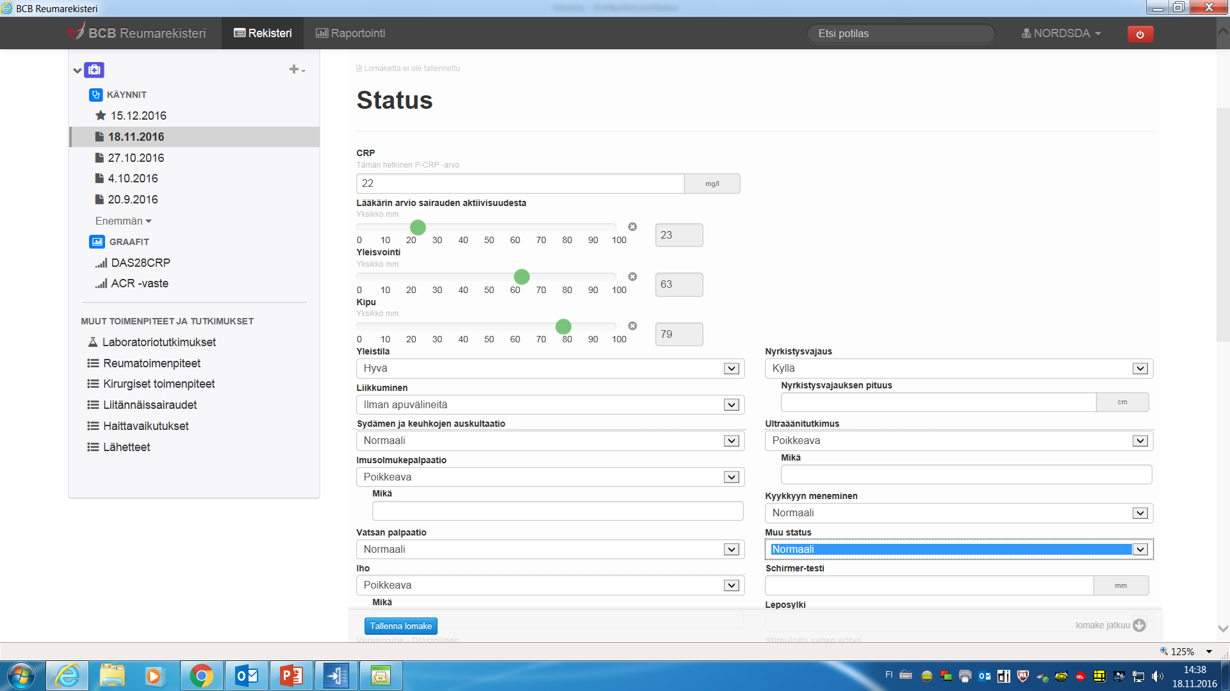

Slide 8
DATA merging
Hospital discharge register (HILMO)
  Hospital treatment (reason for hospitalization, lenght of stay, operations performed, expenditures etc.)
Cancer register (syöpärekisteri)
  (Type, location, behaviour etc.)
Arthroplasty register (implanttirekisteri)
  (Primary & revision joint replacement operations, complications, material & model of prosthesis etc.)
KELA registers (ad 2021)
  Pharmacy claims, physical rehibilation, sick leaves etc.)
Pension register (Eläketurvakeskus)
  (Pensions & disability pensions)
Population register (Väestörekisteri)
  (Date of death)

Slide 9
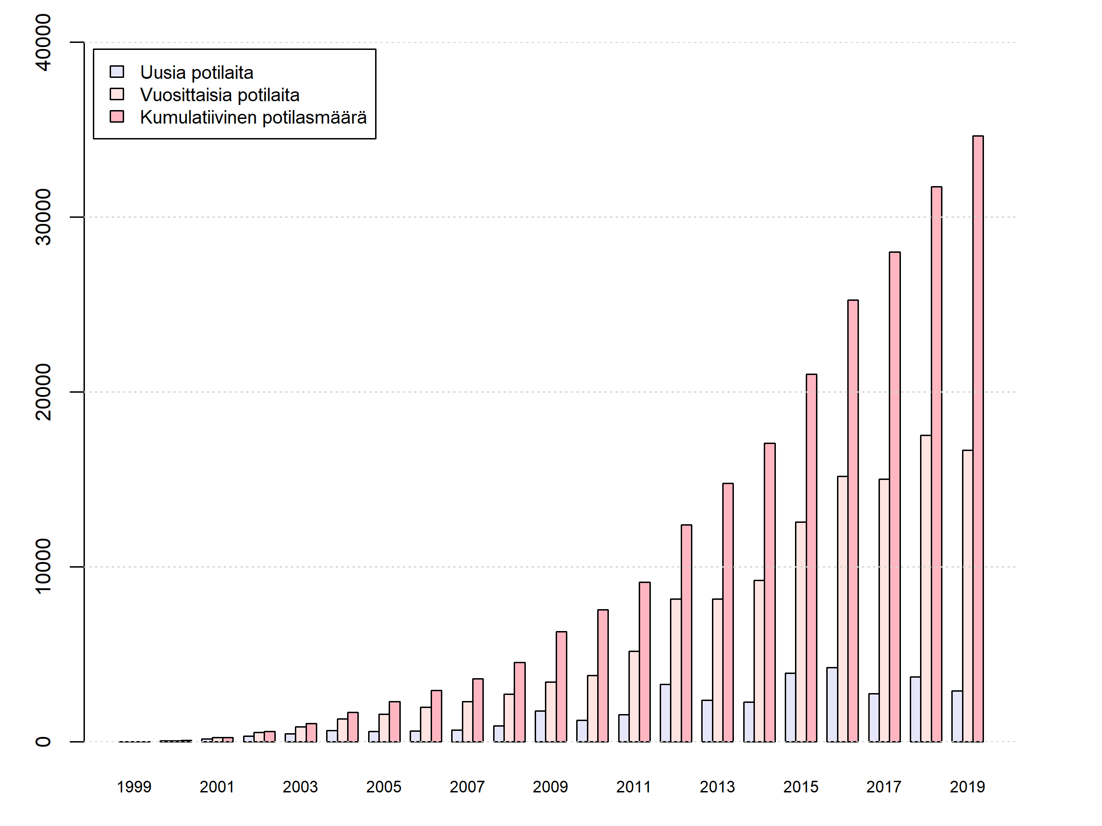
Potilasmäärän kehitys 1999-2019

Slide 10
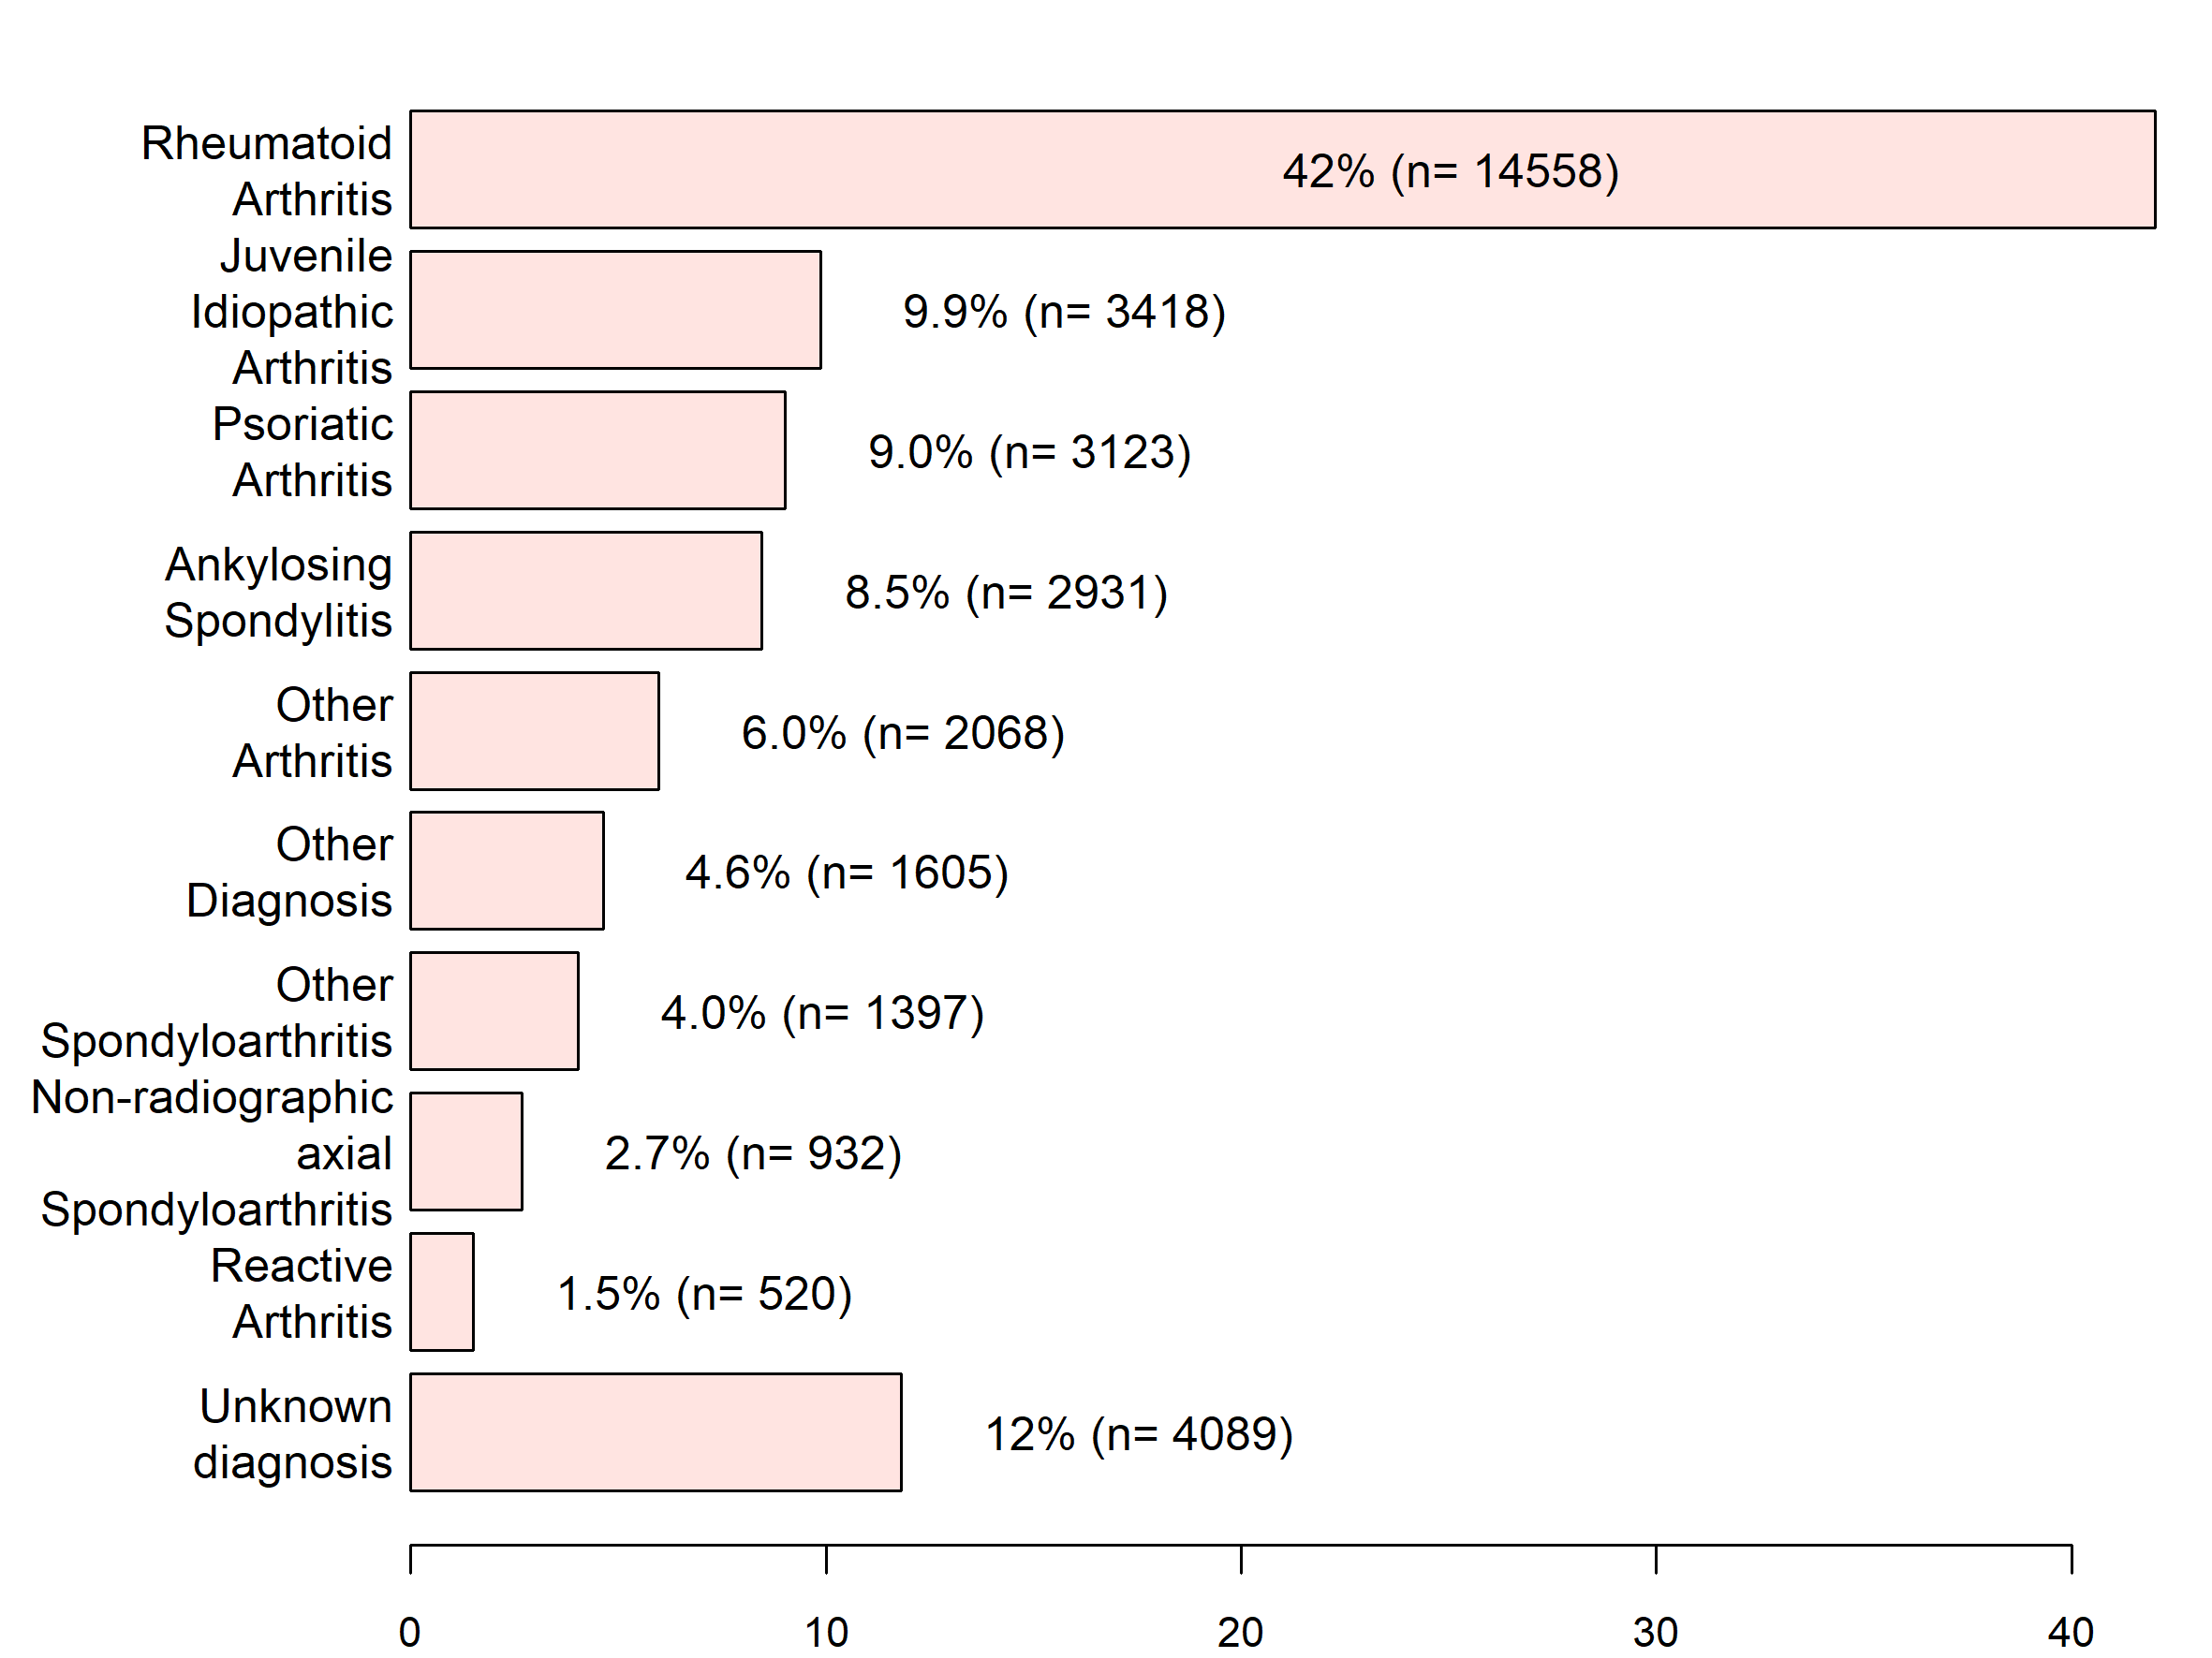
Seurannassa olevien potilaiden diagnoosit 2019
*Tilanne 31.12.2019

Slide 11
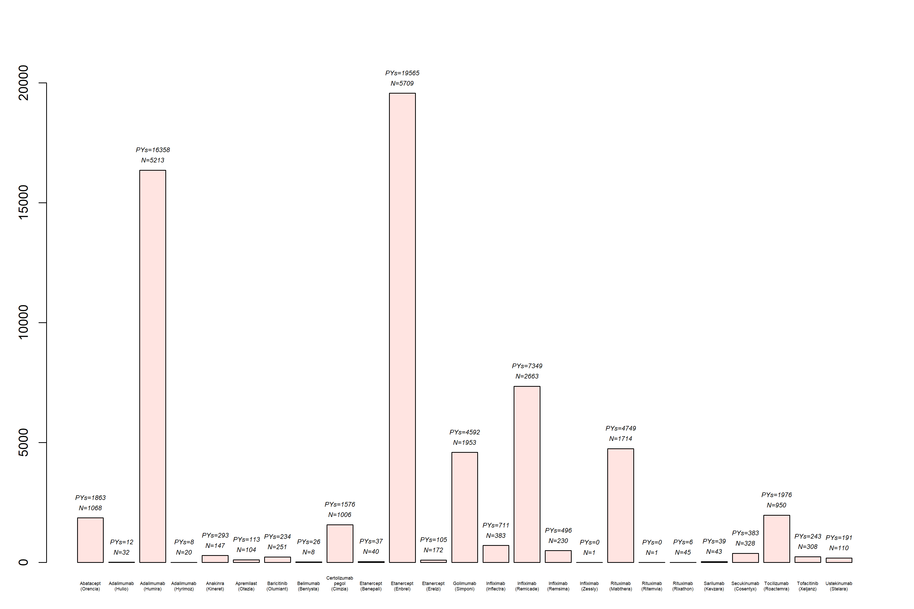
Biologiset ja JAK/PDE4 estäjät - seurantatiedot 2019 loppuun

Slide 12
ROB-FIN työryhmä
TVH Dan Nordström
Rekisterivastaava: FaT Kalle Aaltonen
vts-kirjatyöntekijöitä: FaM Jaana Joensuu; LL Anna-Mari Hokkanen (aloittanut 1.10.18); syventävä työntekijä: LK Jenny Österlund
toimisto-henkilökunta: Data manager FT Nina Trokovic
Neuvoa antava taho
SRY.n tiedonhallintajaos tieteellisen toimikunnan alaisuudessa
Rahoitus: Nord-Forsk, Foreum, Euro-SPA, MSD, Cerrera/Tocerra/JAK-POT,
anottu VTR-rahoitusta

Slide 13
Suunnitelmia
VTS kirja JJ 3-4 osajulkaisua; A-M H 3 -4 osajulkaisua
  Rekisteriin osallistujat mukana osajulkaisujen kirjoittajina
SRY (tietellinen tmk): aloitteet
  ROB-FIN materiaali vapaasti käytettävissä
  Apurahat aineiston täydentämiseen
Kansainvälinen yhteistyö:
  Nord-Forsk: Pohjoismainen rekisteriyhteistyö: RA, AS/SPA, PsA
  Euro-SPA: Eurooppalainen rekisteriyhteistyö. ax-SPA, AS, PsA
  TOCERRA yhteistyö: Eurooppalainen reksiteryhteistyö liittyen tosilitsumabiin (Roche)
  JAK-pot: Eurooppalainen rekisiteryhteistyö liittyen JAKi (Pfizer)

Slide 14
Tuoreimmat julkaisut 2020-
Huoponen S, Aaltonen KJ, Joensuu JT, Rutanen J, Relas H, Taimen K, Puolakka K, Sokka T, Nordström DC, Blom M. The cost-effectiveness of abatacept, tocilizumab, and tnf-inbitors as compared with rituximab as a second-line biological therapy for the treatment of rheumatoid arthritis in Finland. PLOSOne,Published:July 24, 2019
K. Lauper, D. Mongin, F. Iannone, E. K. Kristianslund, T. K. Kvien, D. C. Nordström, K. Pavelka, M. Pombo-Suarez, Z. Rotar, M. J. Santos, C. Codreanu, G. Lukina, S. L. Gale, K. Sarsour, Y Luder, D. S. Courvoisier, C. Gabay. Comparative effectiveness of TNF inhibitors and tocilizumab with and without conventional synthetic disease modifying antirheumatic drugs in bio-naïve patients with rheumatoid arthritis. Seminars in Arthritis Rheum 2020;50:17.
C Heegaard Brahe, L Midtbøll Ørnbjerg, L Jacobsson³, M J. Nissen, E Kristianslund, M José Santos, D Nordström, Z Rotar, B Gudbjornsson, F Onen, C Codreanu, U Lindström, B Möller, T K Kvien, A Barcelos, K K. Eklund, M Tomšič, T Jon Love, G Can, R Ionescu, A G Loft, H Mann, K Pavelka, M Van de Sande, I.E. van der Horst-Bruinsma,, J Gómez Reino, C Sánchez-Piedra, G J. Macfarlane, F Iannone²³, L Hejl Hyldstrup, N Steen Krogh, M Østergaard, M L Hetland . Drug retention and response rates in 14,261 biologic-naïve patients with psoriatic arthritis starting TNF inhibitor treatment in routine care – results from 12 registries in the EuroSpA Research Network Collaboration. Rheumatology 59:1640-50, 2020.
Lykke Midtbøl Ørnbjerg, Cecilie Heegaard Brahe, Johan Askling, Adrian Ciurea, Herman Mann, Fatos Onen, Eirik K Kristianslund, Dan Nordström, Maria José Santos, Catalin Codreanu, Juan Gómez Reino, Ziga Rotar, Bjorn Gudbjornsson, Daniela Di Giuseppe, Michael J. Nissen, Karel Pavelka, Merih Birlik, Tore K Kvien, Kari K. Eklund, Anabela Barcelos, Ruxandra Ionescu, Carlos Sánchez-Piedra, Matija Tomšič, Arni Jon Geirsson, Anne Gitte Loft, Irene E van der Horst-Bruinsma, Gareth Jones, Florenzo Iannone, Lise Hejl Hyldstrup, Niels Steen Krogh, Merete Lund Hetland, Mikkel Østergaard. Treatment response and drug retention rates in 24,195 biologic-naïve patients with axial spondyloarthritis initiating TNFi treatment – routine care data from 12 registries in the EuroSpA collaboration. Ann Rheum Dis 78:1536-44, 2019.
Glintborg B, et al.. Lindström U, Glintborg B, Di Giuseppe D, Nordström D, Aarrestad Provan S, Gudbjornsson B, Askling J, Lund Hetland M, Aaltonen K, Krogh NS, Geirsson AJ, Jacobsson LTH. Treatment retention of originator versus biosimilar infliximab and etanercept in 2334 biologics-naïve patients with spondyloarthritis – a Nordic collaborative observational study. RMD Open. 2019 Oct 23;5(2):e001079. doi: 10.1136/rmdopen-2019-001079. eCollection 2019.
Lindström U, Glintborg B, Di Giuseppe D, Nordström D, Aarrestad Provan S, Gudbjornsson B, Askling J, Lund Hetland M, Aaltonen K, Krogh NS, Geirsson AJ, Jacobsson LTH. Treatment retention of infliximab and etanercept originator versus the corresponding biosimilars in 2334 biologics-naïve patients with spondyloarthritis – a Nordic collaborative observational study. RMD Open. 2019 Oct 23;5(2).
R. L. Hansen, T. S. Jørgensen, L. Dreyer, M. L Hetland, B. Glintborg, J. Askling, D. Di Giuseppe, L. Jacobsson, J. K. Wallman, D. Nordström, K. Aaltonen, E. K. Kristianslund, T. K. Kvien, S. A. Provan, B. Gudbjornsson, T. J. Love, and L. E. Kristensen. Patient characteristics and changes in prescription patterns in psoriatic arthritis patients starting first course of biologic therapies – inflammatory hallmarks of lesser prominence: a Nordic population-based cohort study. Rheumatology, in press, 2020.
Brigitte Michelsen, Lykke Midtbøll Ørnbjerg, Tore K Kvien, Karel Pavelka, Michael J Nissen, Dan Nordström, Maria José Santos, Suleyman Serdar Koca, Johan Askling, Ziga Rotar, Björn Gudbjörnsson, Catalin Codreanu, Anne Gitte Loft, Eirik Klami Kristianslund, Herman F Mann, Adrian Ciurea, Kari K Eklund, ym. - Impact of discordance between patient’s and evaluator’s global on TNFi retention and remission in 14868 spondyloarthritis in the EuroSpA Research Collaboration Network. Rheumatology 59:2455-61, 2020.
Karin Hellgren, Christine Ballegaard, Bénédicte Delcoigne, René Cordtz, Dan Nordström, Kalle Aaltonen, Bjorn Gudbjornsson, Thorvardur Jon Love, Sella Aarrestad Provan, Joe Sexton, Kristian Zobbe, Lars Erik Kristensen, Johan Askling, Lene Dryer. Risk of solid cancers overall and by subtypes in patients with psoriatic arthritis treated with tumour necrosis factor inhibitors. A Nordic cohort study. In press, Rheumatology, 2020.

Slide 15
ROB-FIN Publications 2018-2015
Chatzidionysiou K, Lukina G, Gabay C, Hetland ML, Hauge EM, Pavelka K, Nordström DC⁶, Canhão H, Tomsic M, Rota Z, Lie E, Kvien TK, Vollenhoven RF, Saevarsdottir S. Smoking and Response to Rituximab in Rheumatoid Arthritis – Results from an International European Collaboration. Scand J Rheumatol 2018; 27:1-7.
Chatzidionysiou K, Lund Hetland M, Frisell T, Giuseppe D, Hellgren K, Glintborg B, Nordström DC⁶, Aaltonen K¹, Törmänen M, Kristianslund EK, Kvien T, Provan SA, Gudbjornsson B, Dreyer L, Kristensen LE, Jørgensen TS, Jacobsson L, Askling J. Opportunities and challenges for real world studies on chronic inflammatory joint diseases through data enrichment and collaboration between national registers: the Nordic example. RMD Open, 2018 Apr 12;4(1):e000655. doi: 10.1136/rmdopen-2018-000655. eCollection
Lauper K, Nordström DC⁶, Pavelka K, Hernandez K, Kvien TK, Kristianslund EK, Santos MJ, Rotar Z, Iannone F, Codreanu C, Lukina G, Gale SL, Sarsour K, Luder Y, Courvoisier DS, Gabay C. Comparative effectivenessa of tocilizumab as monotherapy versus TNF inhibitors in combination with csDMARDs for rheumatoid arthritis after the use of at least one bDMARDs. Ann Rheum Dis. 2018; 77:1276.
Lauper K, Mongin D, Iannone F, Kristianslund EK, Kvien TK, Nordström DC⁶, Pavelka K, Pombo-Suarez M, Rotar Z, Santos MJ, Codreanu C, Lukina G, Courvoisier DS, Gabay C. Comparative effectiveness of subcutaneous tocilizumab versus intravenous tocilizumab in a pan-European collaboration of registries. RMD Open. 2018 ; 5;4 (2):000809.
Glintborg B, Lindström U, Aaltonen KJ¹, Kristianslund EK, Gudbjornsson B, Chatzidionysiou K, Askling J, Nordström DC⁶, Hetland ML, Di Giuseppe D, Dreyer L, Kristensen LE, Jørgensen TS, Eklund K⁶, Grondal G, Ernestam S, Joensuu JT¹, Törmänen M¹, Skydsgaard H, Hagfors J, Kvien TK, Lie E, Fagerli K, Geirsson AJ, Jonsson H, Provan SA, Krogh NS, Jacobsson L. Biological treatment in ankylosing spondylitis in the Nordic countries during 2010-2016: a collaboration between five biological registries. Scand J Rheumatol. 2018;Aug:1-10.
Aaltonen KJ¹, Joensuu JT¹, Pirilä L⁷, Kauppi M¹⁶, Uutela T¹⁵, Varjolahti-Lehtinen T¹³, Yli-Kerttula T⁷, Isomäki P¹³, Nordström DC⁶, Sokka T⁴. Drug survival on tumour necrosis factor inhibitors in patients with rheumatoid arthritis in Finland. Scand J Rheumatol. 2017;46(5):359-363.
Aaltonen KJ¹, Ylikylä S¹, Joensuu JT¹, Isomäki P¹³, Pirilä L⁷, Kauppi M¹⁶, Rannio T^{4,18}, Eklund K⁶, Blom M¹, Nordström DC⁶. Efficacy and effectiveness of tumour necrosis factor inhibitors in the treatment of rheumatoid arthritis in randomized controlled trials and routine clinical practice. Rheumatology. 2017;56(5):725-735.
Joensuu JT¹, Aaltonen KJ¹, Aronen P¹, Sokka T⁴, Puolakka K²⁵, Tuompo R⁶, Korpela M¹³, Vasala M²⁶, Ilva K¹⁷, Nordström DC⁶, Blom M¹. Cost-effectiveness of biologic compared with conventional synthetic disease-modifying anti-rheumatic drugs in patients with rheumatoid arthritis: a Register study. Rheumatology. 2016;55(10):1803-1811.
Heinonen AV¹, Aaltonen KJ¹, Joensuu JT¹, Lähteenmäki J¹⁹, Pertovaara MI, Romu M⁶, Hirvonen HE⁶, Similä AK⁸, Blom M¹, Nordström DC⁶. Effectiveness and Drug Survival of TNF Inhibitors in the Treatment of Ankylosing Spondylitis: A Prospective Cohort Study. J Rheumatol. 2015;42(12):2339-46.

Slide 16
ROB-FIN Publications 2015-2006
Aaltonen KJ¹, Joensuu JT¹, Virkki LM¹, Sokka T⁴, Aronen P¹, Relas H⁶, Valleala H⁶, Rantalaiho V¹³, Pirilä L⁷, Puolakka K²⁵, Uusitalo T, Blom M¹, Konttinen YT, Nordström DC⁶. Rates of serious infections and malignancies among patients with rheumatoid arthritis receiving either tumor necrosis factor inhibitor or rituximab therapy. J Rheumatol. 2015;42(3):372-378.
Aaltonen KJ¹, Virkki LM¹, Jämsen E^{2,3}, Sokka T⁴, Konttinen YT, Peltomaa R⁶, Tuompo R⁶, Yli-Kerttula T⁷, Kortelainen S⁸, Ahokas-Tuohinto P⁹, Blom M¹, Nordström DC⁶. Do biologic drugs affect the need for and outcome of joint replacements in patients with rheumatoid arthritis? A register-based study. Seminars in Arthritis and Rheumatism. 2013;43(1):55-62.
Virkki LM¹, Valleala H⁶, Takakubo Y², Vuotila J¹⁰, Relas H⁶, Komulainen R¹¹, Koivuniemi R⁶, Yli-Kerttula U^{12,13}, Mali M⁸, Sihvonen S¹⁴, Krogerus M-L¹⁵, Jukka E⁷, Nyrhinen S⁶, Konttinen YT, Nordström DC⁶. Outcomes of switching anti-TNF drugs in rheumatoid arthritis--a study based on observational data from the Finnish Register of Biological Treatment (ROB-FIN). Clinical rheumatology. 2011;30(11):1447–54.
Virkki LM¹, Sumathikutty BC¹, Aarnio M⁶, Valleala H⁶, Heikkilä R⁶, Kauppi M¹⁶, Karstila K¹³, Pirilä L⁷, Ekman P⁷, Salomaa S¹⁵, Romu M⁶, Seppälä J¹⁷, Niinisalo H¹⁸, Konttinen YT, Nordström DC⁶. Biological therapy for psoriatic arthritis in clinical practice: outcomes up to 2 years. The Journal of rheumatology. 2010;37(11):2362–8.
Virkki L¹, Aaltonen K¹, Nordström DC⁶. Biologiset reumalääkkeet – käytännön kokemukset rekisteritulosten valossa. Duodecim. 2010;126:1487–95.
Virkki LM¹, Konttinen YT, Peltomaa R⁶, Suontama K⁶, Saario R⁸, Immonen K¹⁹, Jäntti J¹⁶, Tuomiranta T²⁰, Nykänen P²¹, Hämeenkorpi R²², Heikkilä S¹⁵, Isomäki P¹³, Nordström D⁶. Cost-effectiveness of infliximab in the treatment of rheumatoid arthritis in clinical practice. Clinical and experimental rheumatology. 2008;26(6):1059–66.
Konttinen L¹, Tuompo R⁶, Uusitalo T⁶, Luosujärvi R¹⁸, Laiho K¹⁶, Lähteenmäki J¹⁹, Puurtinen-Vilkki M⁸, Lanteri R¹², Kortelainen S¹⁸, Karilainen H⁷, Varjolahti-Lehtinen T¹³, Nordström D⁶. Anti-TNF therapy in the treatment of ankylosing spondylitis: the Finnish experience. Clinical rheumatology. 2007;26(10):1693–700.
Konttinen L¹, Kankaanpää E⁶, Luosujärvi R¹⁸, Blåfield H¹², Vuori K⁸, Hakala M¹⁶, Rantalaiho V¹³, Savolainen E²³, Uutela T¹⁵, Nordström D⁶. Effectiveness of anakinra in rheumatic disease in patients naive to biological drugs or previously on TNF blocking drugs: an observational study. Clinical rheumatology. 2006;25(6):882–4.
Konttinen L¹, Honkanen V⁶, Uotila T¹³, Pöllänen J⁶, Waahtera M²⁴, Romu M⁶, Puolakka K²⁵, Vasala M²⁶, Karjalainen A²⁷, Luukkainen R⁷, Nordström DC⁶. Biological treatment in rheumatic diseases: results from a longitudinal surveillance: adverse events. Rheumatology international. 2006;26(10):916–22.
Nordström DC⁶, Konttinen L^{2,3}, Korpela M¹³, Tiippana-Kinnunen T⁶, Eklund K⁶, Forsberg S¹⁹, Ilva K¹⁷, Kaipiainen-Seppänen O¹⁸, Malmi T¹², Ylä-Kerttula T⁸, Honkanen V¹⁶. Classic disease modifying anti-rheumatic drugs (DMARDs) in combination with infliximab. The Finnish experience. Rheumatology international. 2006;26(8):741–8.

