Slide 1
KANSALLINEN REUMAREKISTERI-TUTKIMUS (ROB-FIN 2023)
Prospektiivinen kohorttitutkimus biologisten reumalääkkeiden käyttäjistä
Suomen reumatologisen yhdistyksen (SRY) vuonna 1999 perustama
Tiedonkeruu tapahtuu erikoissairaanhoidon seurantakäyntien yhteydessä
Sähköiset potilasalustat pääsääntöisesti käytössä (GotreatIT, BCB, RAIQU)

Slide 2
TUTKIMUKSEN TAVOITTEET
Reumarekisteritutkimuksen tavoitteena on tuottaa tietoa reumasairauksien epidemiologiasta sekä reuman lääkehoidon vaikuttavuudesta, haittavaikutuksista ja kustannusvaikuttavuudesta terveydenhuollon arjessa
Tiedon avulla voidaan kehittää reumasairauksien hoitoa mm. kohdentamalla lääkehoitoa siitä parhaiten hyötyville potilaille
Datan keruu sallii myös luvallisen kansainvälisen yhteistyön muiden kansallisten eurooppalaisten rekisterien kesken (kuten Nord-Forsk, Euro-SpA)

Slide 3
TIETOSISÄLTÖ
Potilaan taustatiedot mukaan lukien taudin luokittelukriteerit
Tautiaktiivisuus lähtötilanteessa ja seurantakäyntien yhteydessä (mm DAS28, ASDAS, DAPSA)
Biologinen (bDMARD)-, pienmolekyläärinen täsmälääkehoito (tsDMARD) sekä muut reumasairauksien hoidossa käytettävät lääkitykset
Hoidon aikana ilmenneet haittavaikutukset
Kansallisten rekisterien (HILMO, syöpärekisteri, Kelan etuusrekisteri, väestörekisteri, eläkerekisteri) kautta saadut lisätiedot

Slide 4
EETTISET NÄKÖKULMAT
Tiedonkeruu perustuu THL:n,Findatan ja HUS:n tutkimuslupaan
Rekisterin ylläpidolle on eettisen toimikunnan sekä tietosuojavaltuutetun puoltavat lausunnot
Potilaiden tunnistetietoja käsitellään vain erityisestä tarpeesta ja sähköinen aineisto säilytetään salattuna. Paperisisista tiedonkeruulomakkeista on luovuttu

Slide 5
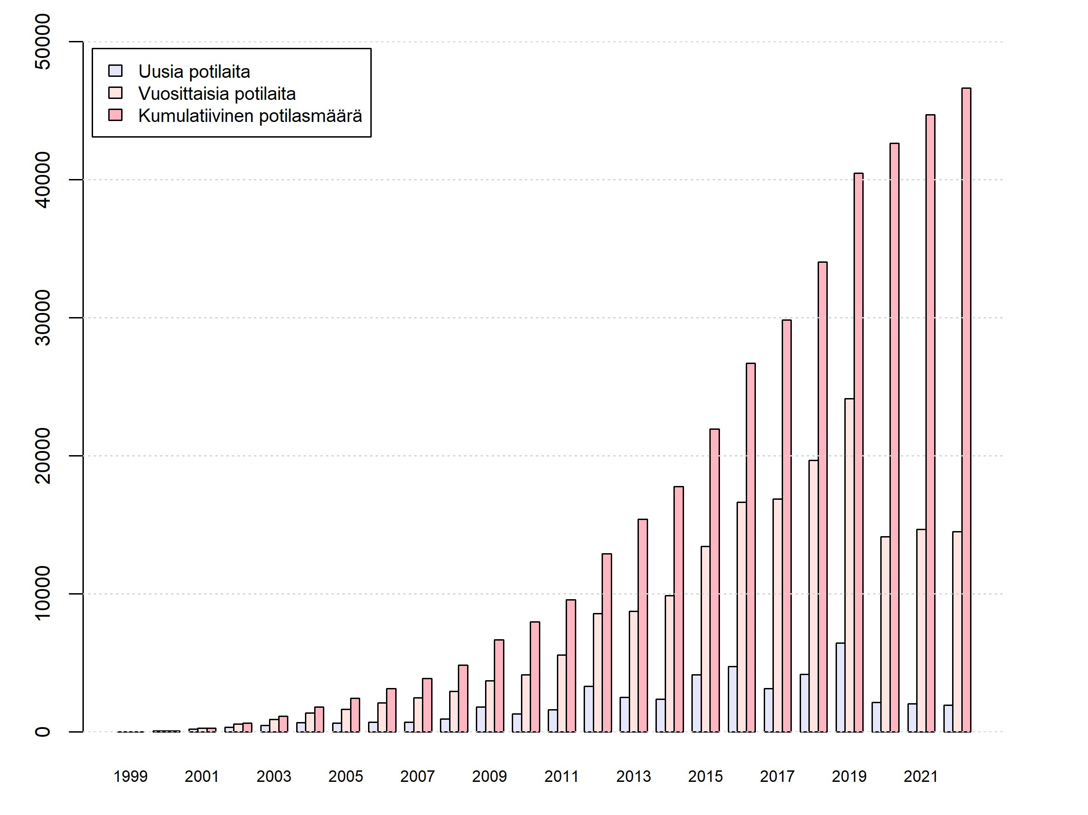
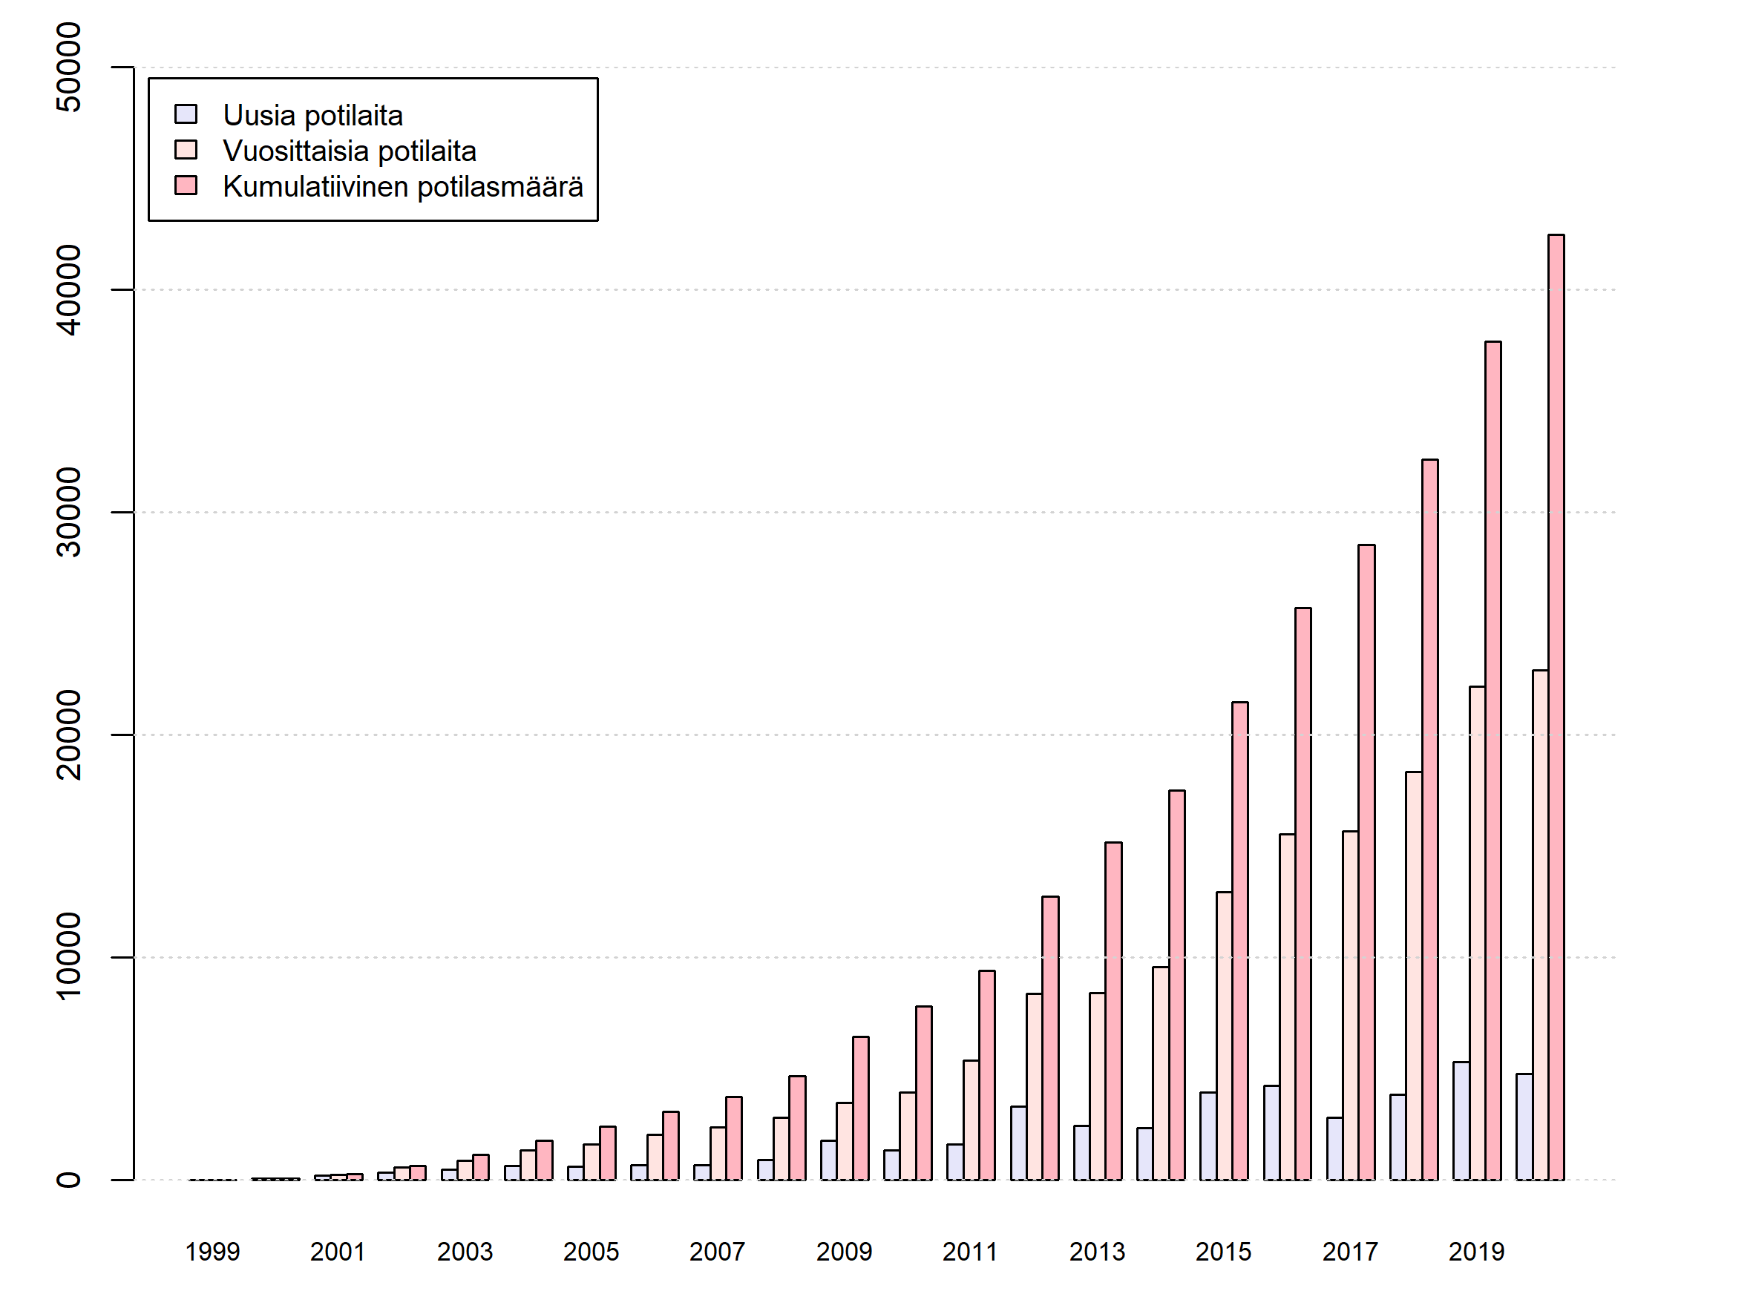
Potilasmäärän kehitys 1999-2022

Slide 6
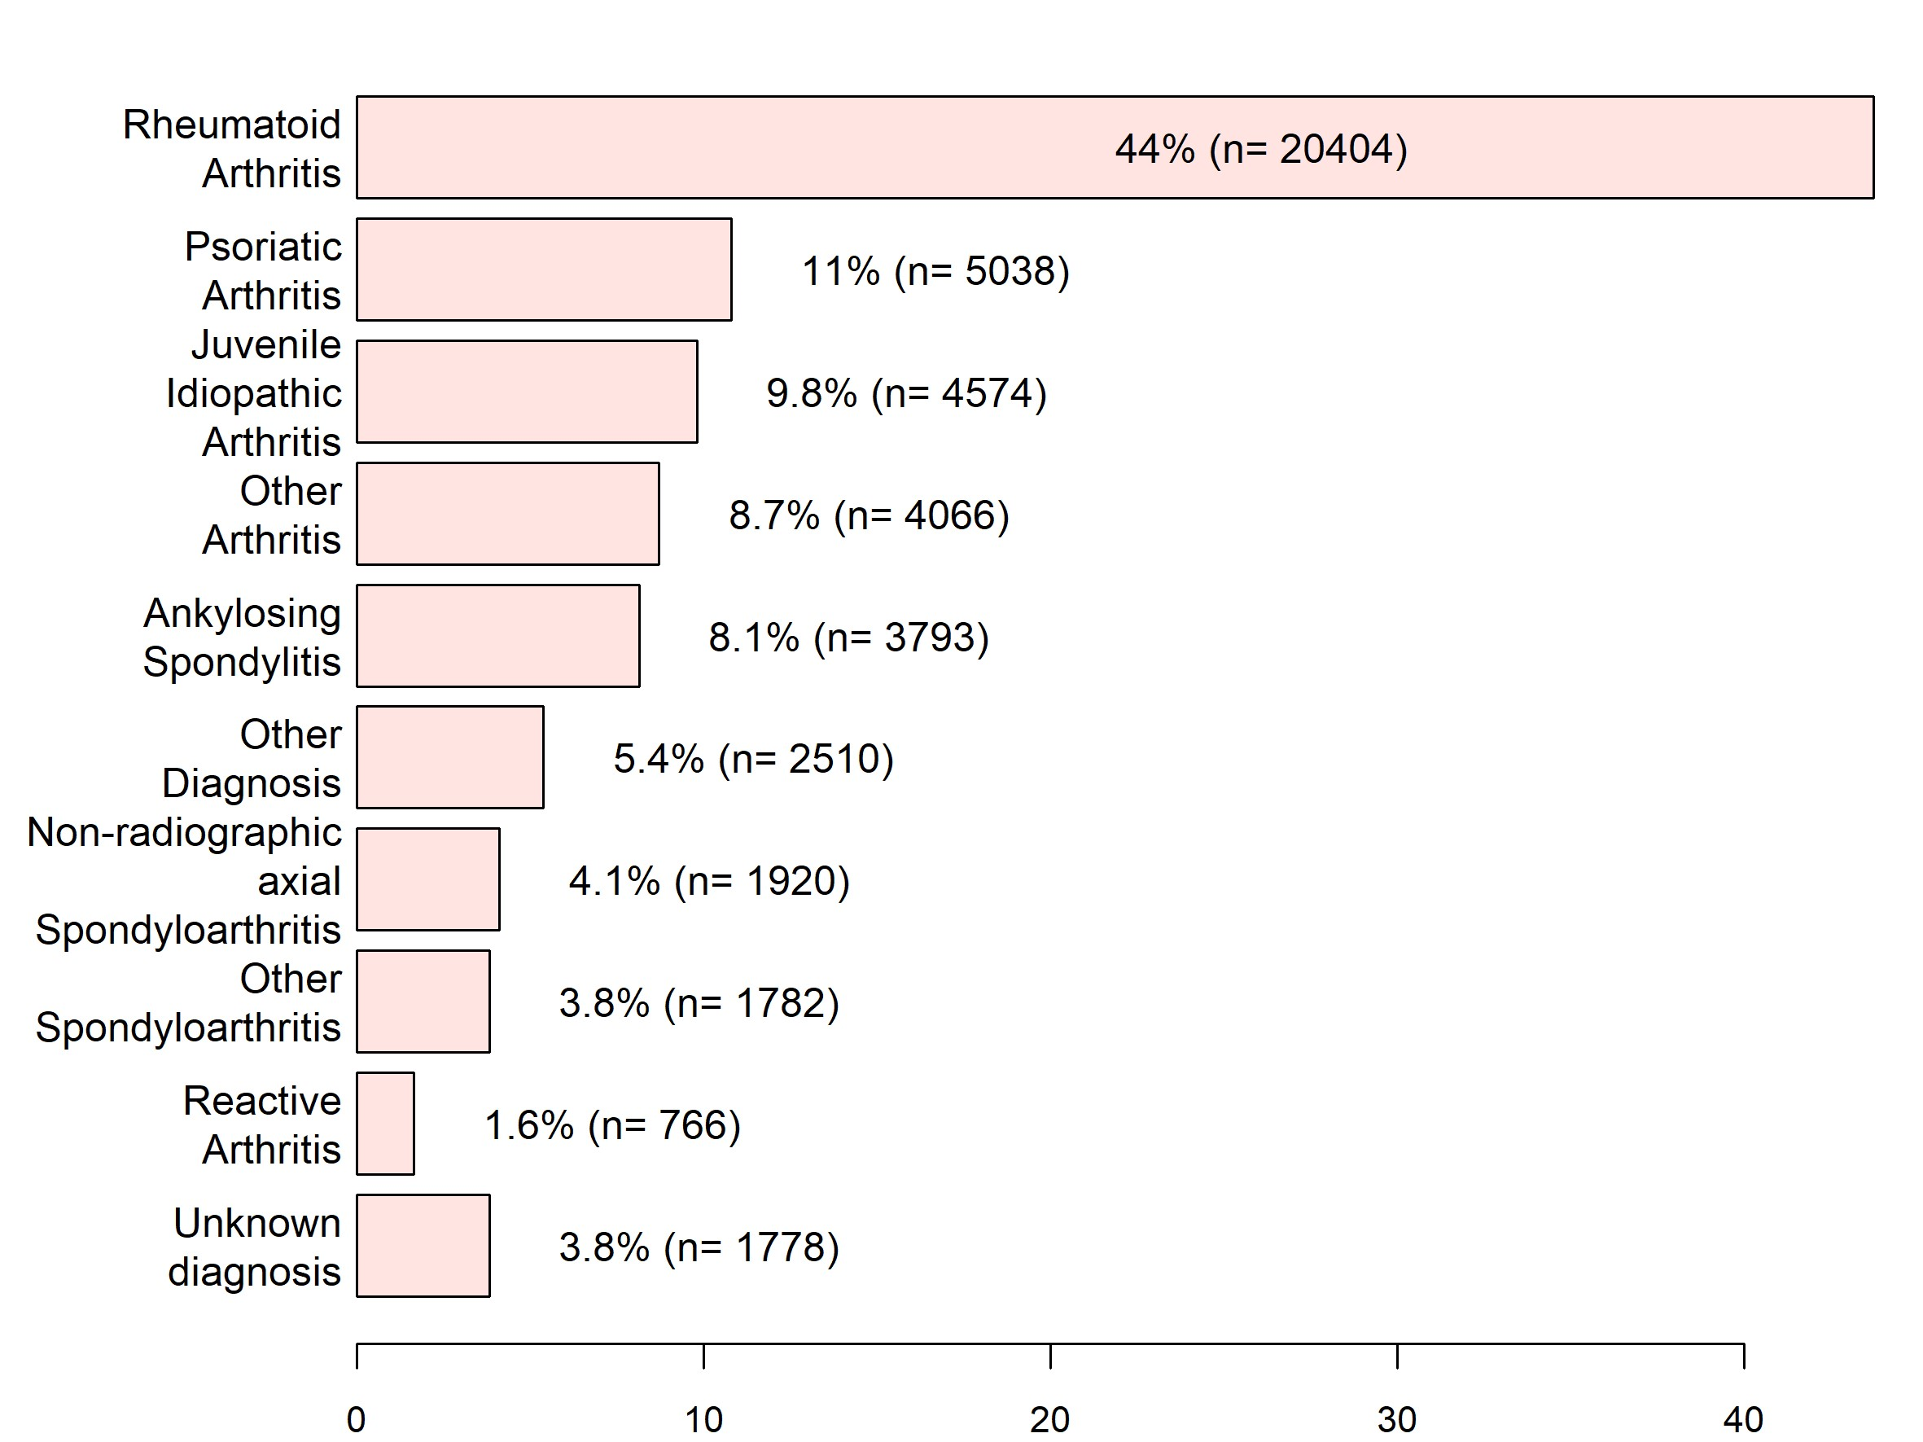
Seurannassa olevien potilaiden diagnoosit*
*Tilanne 31.12.2022, HUS 31.12.21(BCB)

Slide 7
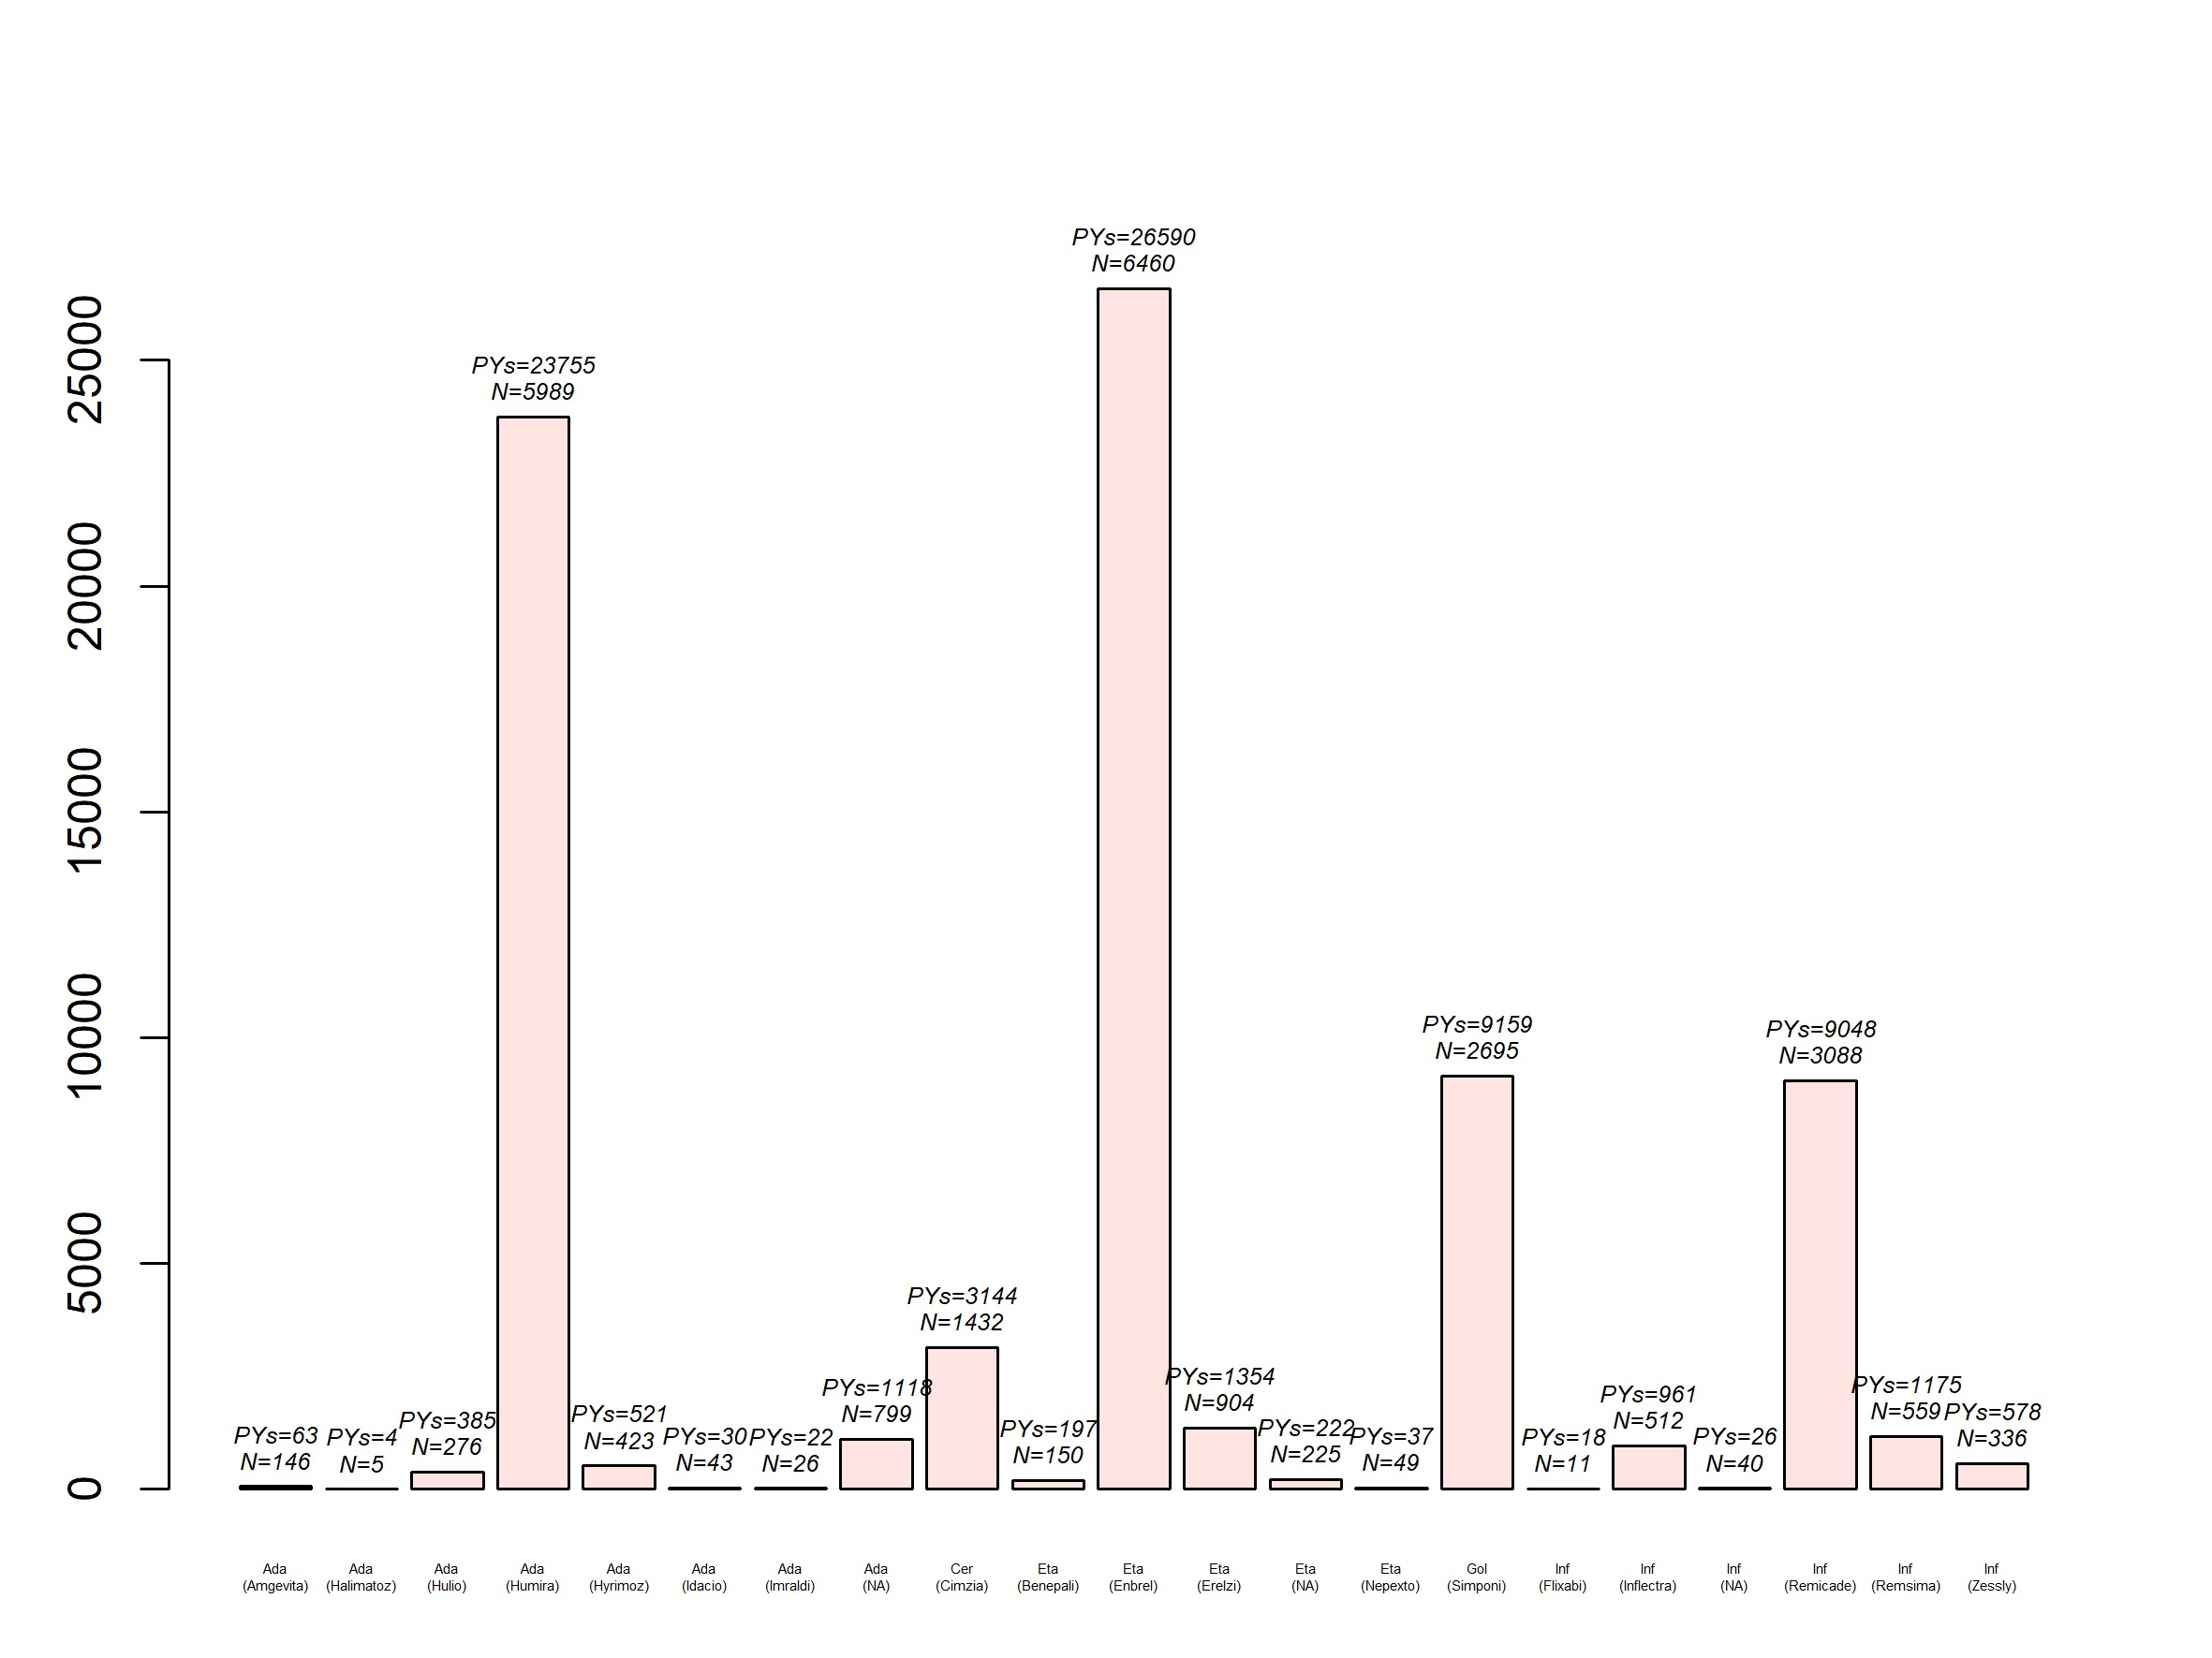
TNF salpaajat – seurantatiedot 2022 loppuun (PY=potilasvuodet)

Slide 8
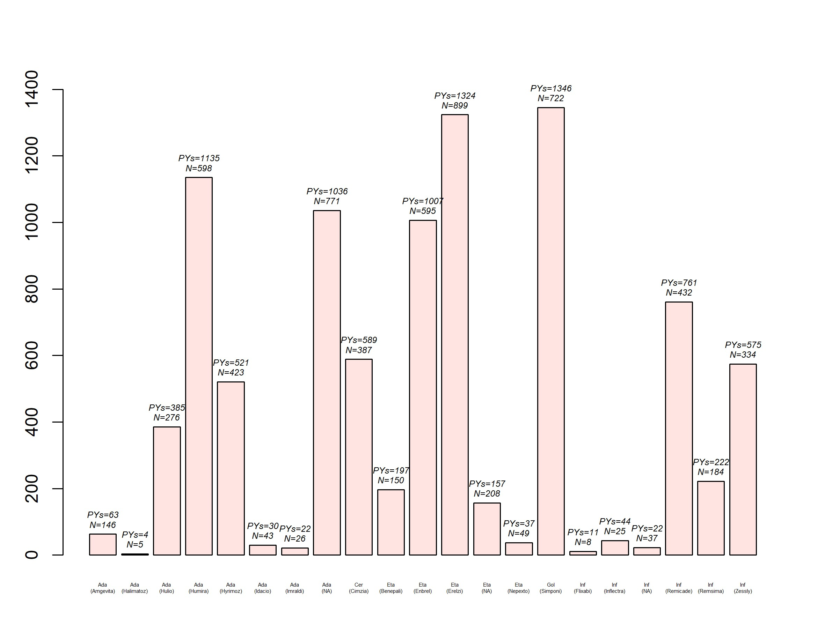
TNF salpaajat – 5v. seurantatiedot 2018-2022 loppuun

Slide 9
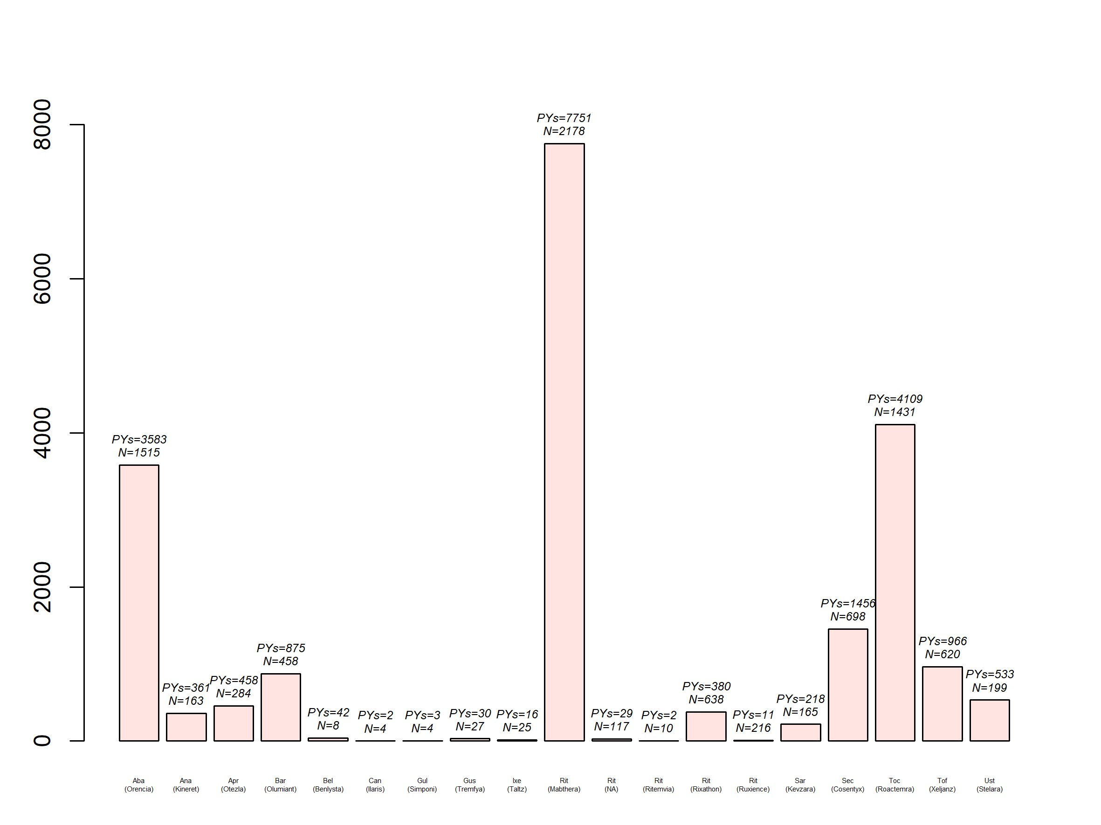
b/tsDMARD (muut kuin TNFi) – seurantatiedot 2022 loppuun

Slide 10
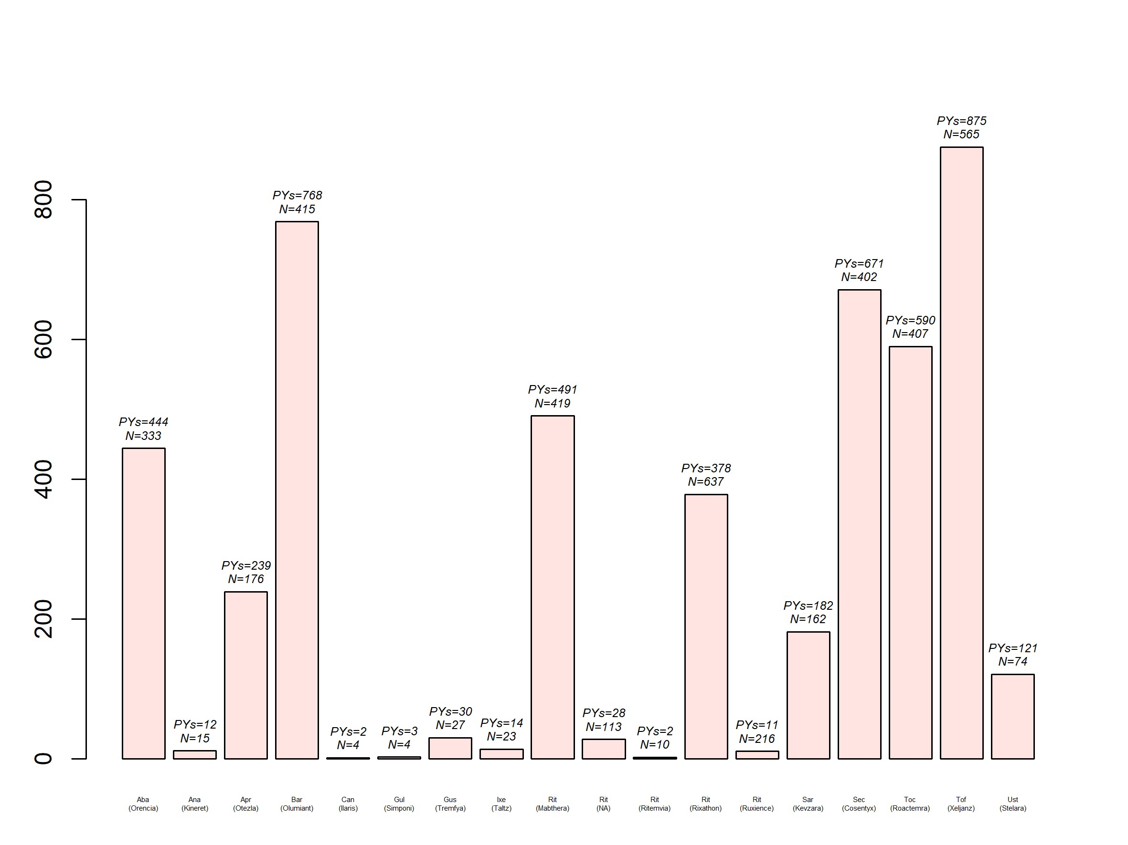
b/tsDMARD (muut kuin TNF-a)– 5v. seurantatiedot 2018-2022

Slide 11
ROB-FIN julkaisut vuodelta 2023
Bente Glintborg , Daniela Di Giuseppe Johan K Wallman Sella Provan Dan Nordström Anna-Mari Hokkanen Jenny Österlund Bjorn Gudbjornsson Merete Lund Hetland Brigitte Michelsen Lennart Jacobsson Johan Askling Ulf Lindström. Is the risk of infections higher during treatment with secukinumab than with TNF-inhibitors. An observational study from the Nordic countries. Rheumatology 1:62:647-658, 2023.
Louise Linde, Stylianos Georgiadis, Lykke Midtbøll Ørnbjerg, Simon Horskjær Rasmussen, Brigitte Michelsen, Ulf Lindström, Johan Askling, Daniela Di Giuseppe, Johan K. Wallman, Jakub Závada, Karel Pavelka, Miguel Bernardes, Carolina Ochôa Matos, Bente Glintborg, Anne Gitte Loft, Dan Nordström, Laura Kuusalo, et al. Comparing predictors of DAPSA, DAPSA28, and DAS28 remission and response at 6 months in patients with psoriatic arthritis initiating a first TNFi in clinical practice – Results from the EuroSpA collaboration. Submitted 2023
Alyssa Dominique, Merete Lund Hetland, Axel Finckh, Jacques-Eric Gottenberg, Florenzo Iannone, Roberto Caporali, Dan Nordstrom, et al. Safety outcomes in patients with rheumatoid arthritis treated with abatacept: Results from a multinational surveillance study across seven European registries. Arthritis Research & Therapy 12:25:101, 2023.
Brigitte Michelsen, Mikkel Østergaard, Michael J Nissen, Adrian Ciurea, Burkhard Möller, Lykke Midtbøll Ørnbjerg, Jakub Zavada, Bente Glintborg, Alan MacDonald, Karin Laas, Dan Nordström, Bjorn Gudbjornsson, Florenzo Iannone, Pasoon Hellmand, Tore K Kvien, Ana M Rodrigues, Catalin Codreanu, Ziga Rotar, Isabel Castrejón Fernández, Johan K Wallman, Jiri Vencovsky, Anne G Loft, Maureen Heddle, Sigrid Vorobjov, Anna-Mari Hokkanen, et al. Differences and similarities between the EULAR/ASAS-EULAR recommendations and national recommendations for treatment of patients with psoriatic arthritis and axial spondyloarthritis across Europe. The Lancet Regional Health – Europe, Aug 4:33:100706, 2023.
Glintborg B, Di Guiseppe D, Wallman J, Nordström D, Gudbjornsson B, Hetland M, Askling J, Gröndal G, Sokka T, et al. Uptake and effectiveness of newer biologic and targeted synthetic disease-modifying anti-rheumatic drugs in psoriatic arthritis. Results from five Nordic biologics registries. Ann Rheum Dis 82:820-28, 2023.
Kathrine Rugbjerg, Lykke Midtbøll Ørnbjerg, Stylianos Georgiadis, Simon Horskjær Rasmussen, Ulf Lindström Karel Pavelka, Neslihan Yılmaz, Ennio Giulio Favalli, Michael J. Nissen, Brigitte Michelsen, Elsa Vieira-Sousa, Gareth T Jones, Ruxandra Ionescu, Heikki Relas, Carlos Sanchez-Piedra, Matija Tomšič, Arni Jon Geirsson, Irene van der Horst-Bruinsma, Johan Askling, Anne Gitte Loft, Lucie Nekvindova, Haner Direskeneli, Florenzo Iannone, Adrian Ciurea, Karen Minde Fagerli, Maria José Santos, Gary J Macfarlane, Catalin Codreanu, Kari Eklund et al. One-third of biologic-naïve patients with axial spondyloarthritis reach patient-reported outcome remission when treated with TNF-inhibitors in routine care in Europe – data from 19,530 patients in the EuroSpA collaboration. J Rheumatol 50:1009-19, 2023.
Bénédicte Delcoigne, Tine Iskov Kopp, Elizabeth Arkema, Karin Hellgren, Sella Aarrestad Provan, Heikki Relas, Kalle Aaltonen, Nina Trokovic, Bjorn Gudbjornson, Gerdur Gröndal⁷, Eirik Klami Kristianslund, Jesper Lindhardsen, Lene Dreyer, Johan Askling. Exposure to specific tumor necrosis factor inhibitors and risk of demyelinating and inflammatory neuropathy in cohorts of patients with inflammatory arthritis. A collaborative observational study across five Nordic rheumatology registers. RMD Open Feb:9:e002924, 2023
Louise Linde, Lykke Midtbøll Ørnbjerg, Stylianos Georgiadis, Simon Horskjær Rasmussen, Ulf Lindström Johan Askling, Brigitte Michelsen, Daniela Di Giuseppe, Johan K. Wallman, Bjorn Gudbjornsson, Thorvardur Jon Love, Dan Nordström Timo Yli-Kerttula, et al. Predictors of DAPSA28 remission in patients with psoriatic arthritis initiating their first TNF-inhibitor: results from 13 European registries. Rheumatology Rheumatology (Oxford) 2023 Jun 14:kead284.doi: 10.1093/rheumatology/kead284. Online ahead of print.
Hokkanen A-M, Aaltonen K, Relas H, Rutanen J, Rannio T, Elfving P, Taimen K, Kauppi M, Puolakka K, Trokovic N, Nordström D. Impact of TNFi medication on work disability in axial spondyloarthritis, an observational cohort study. Rheumatol Adv Pract 25:7rkad50, 2023.

Slide 12
ROB-FIN julkaisut vuosilta 2022-2023
Glintborg B, Lindstrom U, De Giuseppe D, Provan SA, Gudbjornsson B, Hetland ML, Michelsen B, Wallman J, Aaltonen K, Hokkanen AM, Nordström D, et al; DANBIO (Denmark), ARTIS/SRQ (Sweden), ICEBIO (Iceland), ROB-FIN (Finland), NOR-DMARD (Norway) registries. One-year treatment outcomes of secukinumab versus tumor necrosis factor inhibitors in Spondyloarthritis. Arthritis Care Res74:748-58, 2022.
Bénédicte Delcoigne, Sella Aarrestad Provan, Hilde Berner Hammer, Daniela Di Giuseppe, Thomas Frisell, Bente Glintborg, Gerdur Grondal, Bjorn Gudbjornson, Merete Lund Hetland, Brigitte Michelsen, Dan Nordström, Heikki Relas, Johan Askling. Do patient-reported measures of disease activity in rheumatoid arthritis vary across the Nordic countries? Results from a Nordic collaboration. Rheumatology 28:61(12):4998, 2022.
Kim Lauper, Michele Iudici, Denis Mongin, Sytske Anne Bergstra, Denis Choquette, Catalin Codrean, René Lindholm Cordtz, Diederick De Coc8, Lene Dreyer, Ori Elkaya, Ellen Margrethe Hauge, Kimme L. Hyrich, Florenzo Iannone, Nevsun Inanc, Lianne Kearsley-Fleet, Eirik K. Kristianslund, Tore K. Kvien, Burkhard F Leeb, Galina Lukina, Dan C. Nordström, et al. Effectiveness of TNFi, abatacept, IL-6i and JAK-inhibitors and bDMARDs in 31,936 patients with rheumatoid arthritis in 19 registers from the “JAK-pot” collaboration. Ann Rheum Dis 81:1358-66, 2022.
Linde L, Ørnbjerg LM, Brahe CH, Wallman JK, Di Giuseppe D, Závada J, Castrejon I, Díaz-Gonzalez F, Rotar Z, Tomšič M, Glintborg B, Gudbjornsson B, Geirsson AJ, Michelsen B, Kristianslund EK, Santos MJ, Barcelos A, Nordström D, Eklund KK, et al.. Second and third TNF inhibitors in European patients with axial spondyloarthritis: Effectiveness and impact of the reason for switching. Rheumatology (Oxford). 2023 Sep 20:kead494. doi: 10.1093/rheumatology/kead494. Online ahead of print.PMID: 37738257
Lykke Midtbøll Ørnbjerg, Louise Linde, Stylianos Georgiadis, Simon Horskjær Rasmussen, Ulf Lindström, Johan Askling, Brigitte Michelsen, Daniela Di Giuseppe, Johan K. Wallman, Karel Pavelka, Jakub Závada, Michael J. Nissen, Gareth T Jones, Heikki Relas, Laura Pirilä et al.. Predictors of achieving ASDAS inactive disease in axial spondyloarthritis during treatment with TNF-inhibitors: results from the EuroSpA collaboration. Semin Arthritis Rheum 56:152081, 2022.
René Cordtz, Johan Askling, Bénédicte Delcoigne, Karin E. Smedby, Eva Baecklund, Christine Ballegaard, Pia Isomäki, Kalle Aaltonen, Bjorn Gudbjornsson, Thorvardur Jon Love, Sella Aarrestad Provan, Brigitte Michelsen, Joe Sexton, Lene Dreyer, Karin Hellgren.. Hematological malignancies in patients with psoriatic arthritis overall and treated with Tumour Necrosis Factor inhibitors - A Nordic cohort study. RMD Open 8:e002776, 2022.
Manuel Pombo-Suarez, Carlos Sanchez-Piedra, Juan J Gomez-Reino, Kim Lauper, Denis Mongin, Florenzo Iannone, Karel Pavelka, Dan Nordström, Nevsun Inanc, Catalin Codreanu, Kimme L Hyrich, Denis Choquette, Anja Strangfeld, Burkhard Leeb, Ziga Rotar, Ana M Rodrigues, Eirik K Kristianslund, Tore K Kvien, et al: After JAK inhibitor failure: to cycle or to switch, that is the question. Data from the JAK-pot collaboration of registries. Ann Rheum Dis 82:175-81, 2023.

Slide 13
ROB-FIN julkaisut vuodelta 2022
Benedicte Delcoigne, Carl Turesson, Lotta Ljung, Kathrine Lederballe Grøn, Bente Glintborg, Merete Lund Hetland, Sella Aarrestad Provan, Brigitte Michelsen, Ritva Peltomaa, Heikki Relas, Bjorn Gudbjornsson, Johan Askling. Short- and longer-term risks for acute coronary syndrome differ among in cohorts of patients with rheumatoid arthritis starting treatment with different biologic disease-modifying anti-rheumatic drugs: results from four Nordic countries. Ann Rheum Dis 81:789-97, 2022.
Michael J Nissen, Daniela Di Giuseppe, Lennart Jacobsson, Merete Hetland, Adrian Ciurea, Lucie Nekvindova, Florenzo Iannone, Tuulikki Sokka-Isler, Karen Minde Fagerli , Maria Jose Santos, Catalin Codreanu, Manuel Pombo-Suarez, Ziga Rotar, Bjorn Gudbjornsson , Gary Macfarlane, Irene van der Horst, Anne Gitte Loft, Burkhard Möller, Herman Mann,Fabrizio Conti, GozdeYildirim Cetin, Heikki, Relas,Brigitte Michelsen,Pedro Avila Ribeiro,Ruxandra Ionescu, Carlos SanchezPiedra, Matija Tomsic, Árni Jón Geirsson, Johan Askling Bente Glintborg, Ulf Lindström, Combination therapy with conventional synthetic disease-modifying anti-rheumatic drugs in patients with axial spondylarthritis improves TNF inhibitor retention and clinical remission rates: results from the EuroSpA collaboration. Rheumatology 28:4741-51, 2022.
Lykke Midtbøll Ørnbjerg, Louise Linde, Stylianos Georgiadis, Simon Horskjær Rasmussen, Ulf Lindström, Johan Askling, Brigitte Michelsen, Daniela Di Giuseppe, Johan K. Wallman, Karel Pavelka, Jakub Závada, Michael J. Nissen, Gareth T Jones, Heikki Relas, Laura Pirilä, Matija Tomšič, Arni Jon Geirsson, Irene van der Horst-Bruinsma, Anne Gitte Loft, Bente Glintborg, Karin Laas, Florenzo Iannone, Addolorata Corrado, Adrian Ciurea, Maria José Santos, Helena Santos, Catalin Codreanu, Eirik Klami Kristianslund, Ziga Rotar, Bjorn Gudbjornsson, Nurullah Akkoc, Ozgul Soysal Gunduz, Mikkel Østergaard, Merete Lund Hetland. Predictors of achieving ASDAS inactive disease in axial spondyloarthritis during treatment with TNF-inhibitors: results from the EuroSpA collaboration. Semin Arthritis Rheum 56:152081, 2022.
René Cordtz, Johan Askling, Bénédicte Delcoigne, Karin E. Smedby, Eva Baecklund, Christine Ballegaard, Pia Isomäki, Kalle Aaltonen, Bjorn Gudbjornsson, Thorvardur Jon Love, Sella Aarrestad Provan, Brigitte Michelsen, Joe Sexton, Lene Dreyer, Karin Hellgren. Hematological malignancies in patients with psoriatic arthritis overall and treated with Tumour Necrosis Factor inhibitors - A Nordic cohort study. RMD Open 8:e002776, 2022
Daniela Di Giuseppe , Ulf Lindström, Kalle Aaltonen, Heikki Relas , Sella Provan, Bjorn Gudbjornsson, Merete Lund Hetland, Johan Askling, Markku Kauppi, Arni Jon Geirsson, Katerina Chatzidionysiou , Tanja Schjødt Jørgensen, Lene Dreyer, Brigitte Michelsen, Lennart Jacobsson, Bente Glintborg. The occurrence of multiple treatment switching in axial spondyloarthritis – definition, incidence and patient characteristics. Results from five Nordic rheumatology registries. Rheumatology 30:3647-56, 2022.

Slide 14
ROB-FIN julkaisut vuosilta 2020-2021
Michelsen B, Lindström U, Codreanu C, Ciurea A, Zavada J, Loft AG, Pombo-Suarez M, Onen F, Kvien TK, Rotar Z, Santos MJ, Iannone F, Hokkanen AM, Gudbjornsson B, Askling J, Ionescu R, Nissen MJ, Pavelka K, Sanchez-Piedra C, Akar S, Sexton J, Tomsic M, Santos H, Sebastiani M, Österlund J, Geirsson AJ, Macfarlane G, van der Horst-Bruinsma I, Georgiadis S, Brahe CH, Ørnbjerg LM, Hetland ML, Østergaard M. Drug retention, inactive disease and response rates in 1860 patients with axial spondyloarthritis initiating secukinumab treatment: routine care data from 13 registries in the EuroSpA collaboration. RMD Open Sep;6(3):e001280, 2020.
Michelsen B, Georgiadis S, Di Giuseppe D, Loft AG, Nissen MJ, Iannone F, Pombo-Suarez M, Mann H, Rotar Z, Eklund KK, Kvien TK, Santos MJ, Gudbjornsson B, Codreanu C, Yilmaz S, Wallman JK, Brahe CH, Möller B, Favalli EG, Sánchez-Piedra C, Nekvindova L, Tomsic M, Trokovic N, Kristianslund EK, Santos H, Löve TJ, Ionescu R, Pehlivan Y, Jones GT, van der Horst-Bruinsma I, Ørnbjerg LM, Østergaard M, Hetland ML. Real-world 6 and 12-month Drug Retention, Remission and Response Rates of Secukinumab in 2,017 Psoriatic Arthritis patients in 13 European Countries. Arthritis Care Res (Hoboken). Jan 18. doi: 10.1002/acr.24560. Online ahead of print.PMID: 3346053, 2021.
Lindström U, Di Giuseppe D, Delcoigne B, Glintborg B, Möller B, Ciurea A, Pombo-Suarez M, Sanchez-Piedra C, Eklund K, Relas H, Gudbjornsson B, Love TJ, Jones GT, Codreanu C, Ionescu R, Nekvindova L, Závada J, Atas N, Yolbas S, Fagerli KM, Michelsen B, Rotar Ž, Tomšič M, Iannone F, Santos MJ, Avila-Ribeiro P, Ørnbjerg LM, Østergaard M, Jacobsson LT, Askling J, Nissen MJ.l. Effectiveness and treatment retention of TNF-inhibitors when used as monotherapy versus co-medication with csDMARDs in 15332 patients with psoriatic arthritis. Data from the EuroSpA collaboration. Ann Rheum Dis 80:1410, 2021.

