Slide 1
KANSALLINEN REUMAREKISTERI-TUTKIMUS (ROB-FIN)
Prospektiivinen kohorttitutkimus biologisten reumalääkkeiden käyttäjistä
Suomen reumatologisen yhdistyksen (SRY) vuonna 1999 perustama
Tiedonkeruu tapahtuu erikoissairaanhoidon seurantakäyntien yhteydessä
Sähköiset potilasalustat pääsääntöisesti käytössä (GotreatIT, BCB)

Slide 2
TUTKIMUKSEN TAVOITTEET
Reumarekisteritutkimuksen tavoitteena on tuottaa tietoa reumasairauksien epidemiologiasta sekä reuman lääkehoidon vaikuttavuudesta, haittavaikutuksista ja kustannusvaikuttavuudesta terveydenhuollon arjessa
Tiedon avulla voidaan kehittää reumasairauksien hoitoa mm. kohdentamalla lääkehoitoa siitä parhaiten hyötyville potilaille

Slide 3
TIETOSISÄLTÖ
Potilaan taustatiedot mukaan lukien taudin luokittelukriteerit
Tautiaktiivisuus lähtötilanteessa ja seurantakäyntien yhteydessä
Biologinen (bDMARD)-, pienmolekyläärinen täsmälääkehoito (tsDMARD) sekä muut reumasairauksien hoidossa käytettävät lääkitykset
Hoidon aikana ilmenneet haittavaikutukset
Kansallisten rekisterien (HILMO, syöpärekisteri, Kelan etuusrekisteri, väestörekisteri, eläkerekisteri) kautta saatavat lisätiedot

Slide 4
EETTISET NÄKÖKULMAT
Tiedonkeruu perustuu THL:n ja Findatan tutkimuslupaan
Rekisterin ylläpidolle on eettisen toimikunnan sekä tietosuojavaltuutetun puoltavat lausunnot
Potilaiden tunnistetietoja käsitellään vain erityisestä tarpeesta ja sähköinen aineisto säilytetään salattuna. Paperisisista tiedonkeruulomakkeista on luovuttu

Slide 5
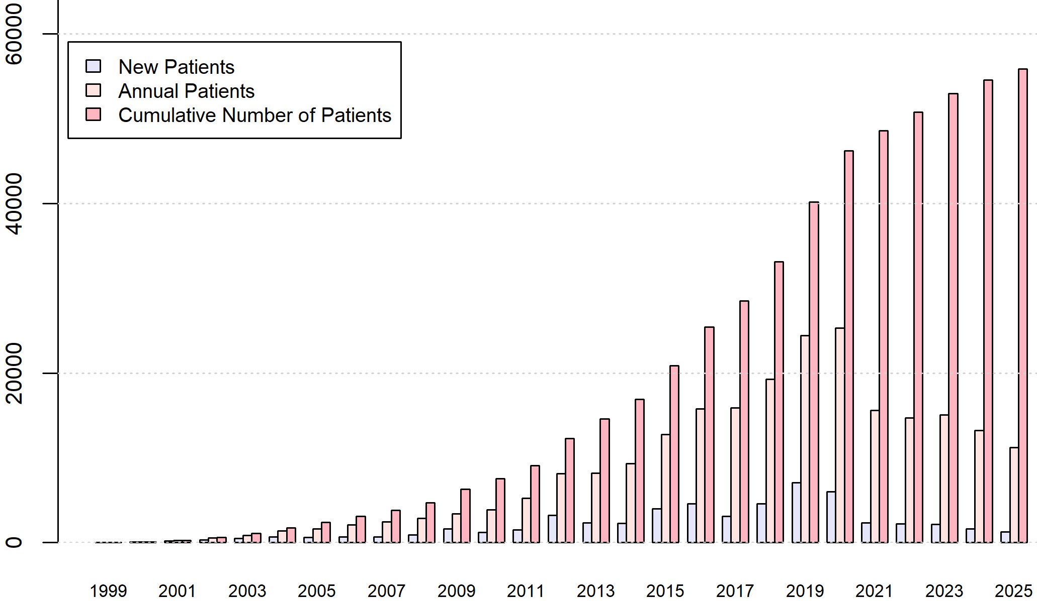
Potilasmäärän kehitys 1999-2025
*Tilanne 12/2025 ISHP data 12/2015 asti HUS, KYS, EKHVA data 12/2020 asti TYKS, SOITE data 12/2024 asti

Slide 6
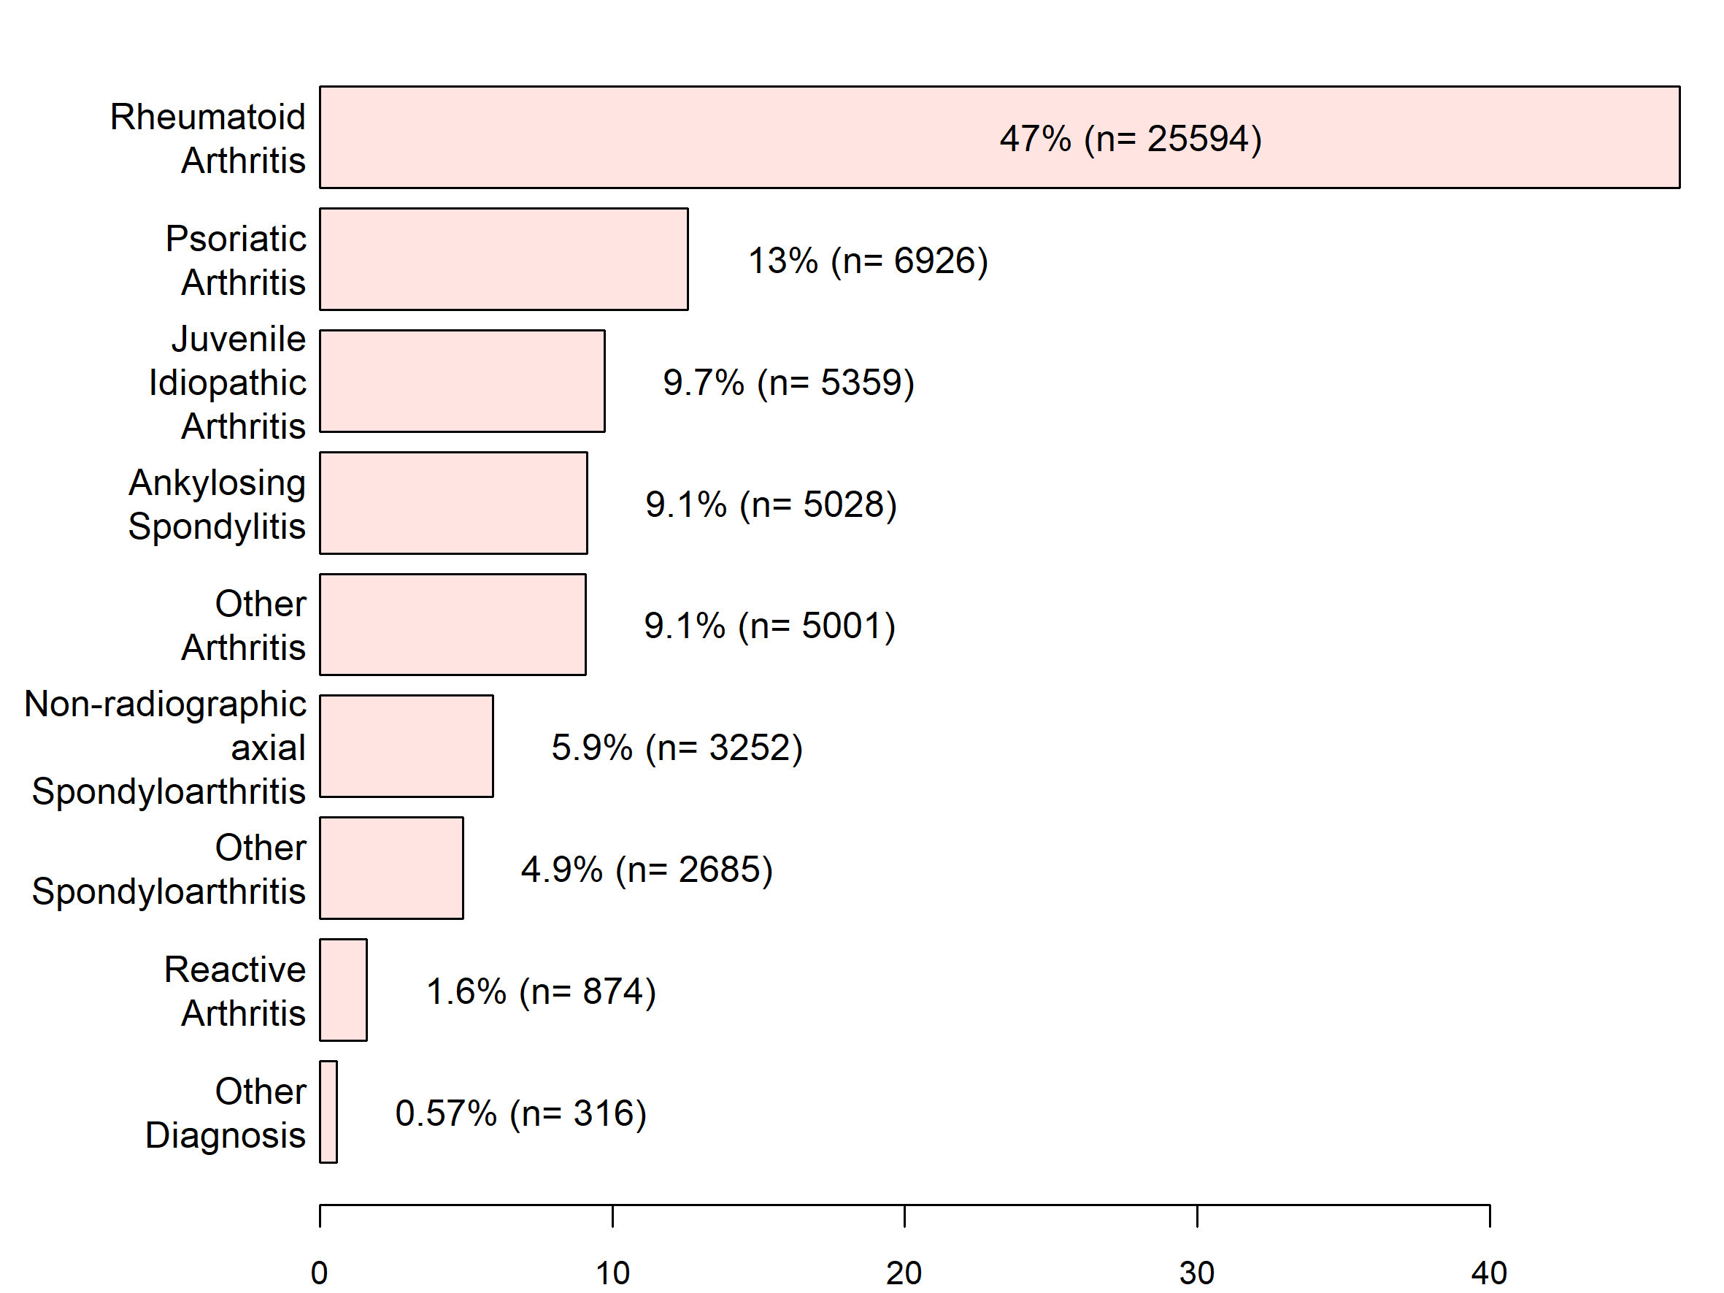
Seurannassa olevien potilaiden diagnoosit
*Tilanne 12/2025 ISHP data 12/2015 asti HUS, KYS, EKHVA data 12/2020 asti TYKS, SOITE data 12/2024 asti

Slide 7
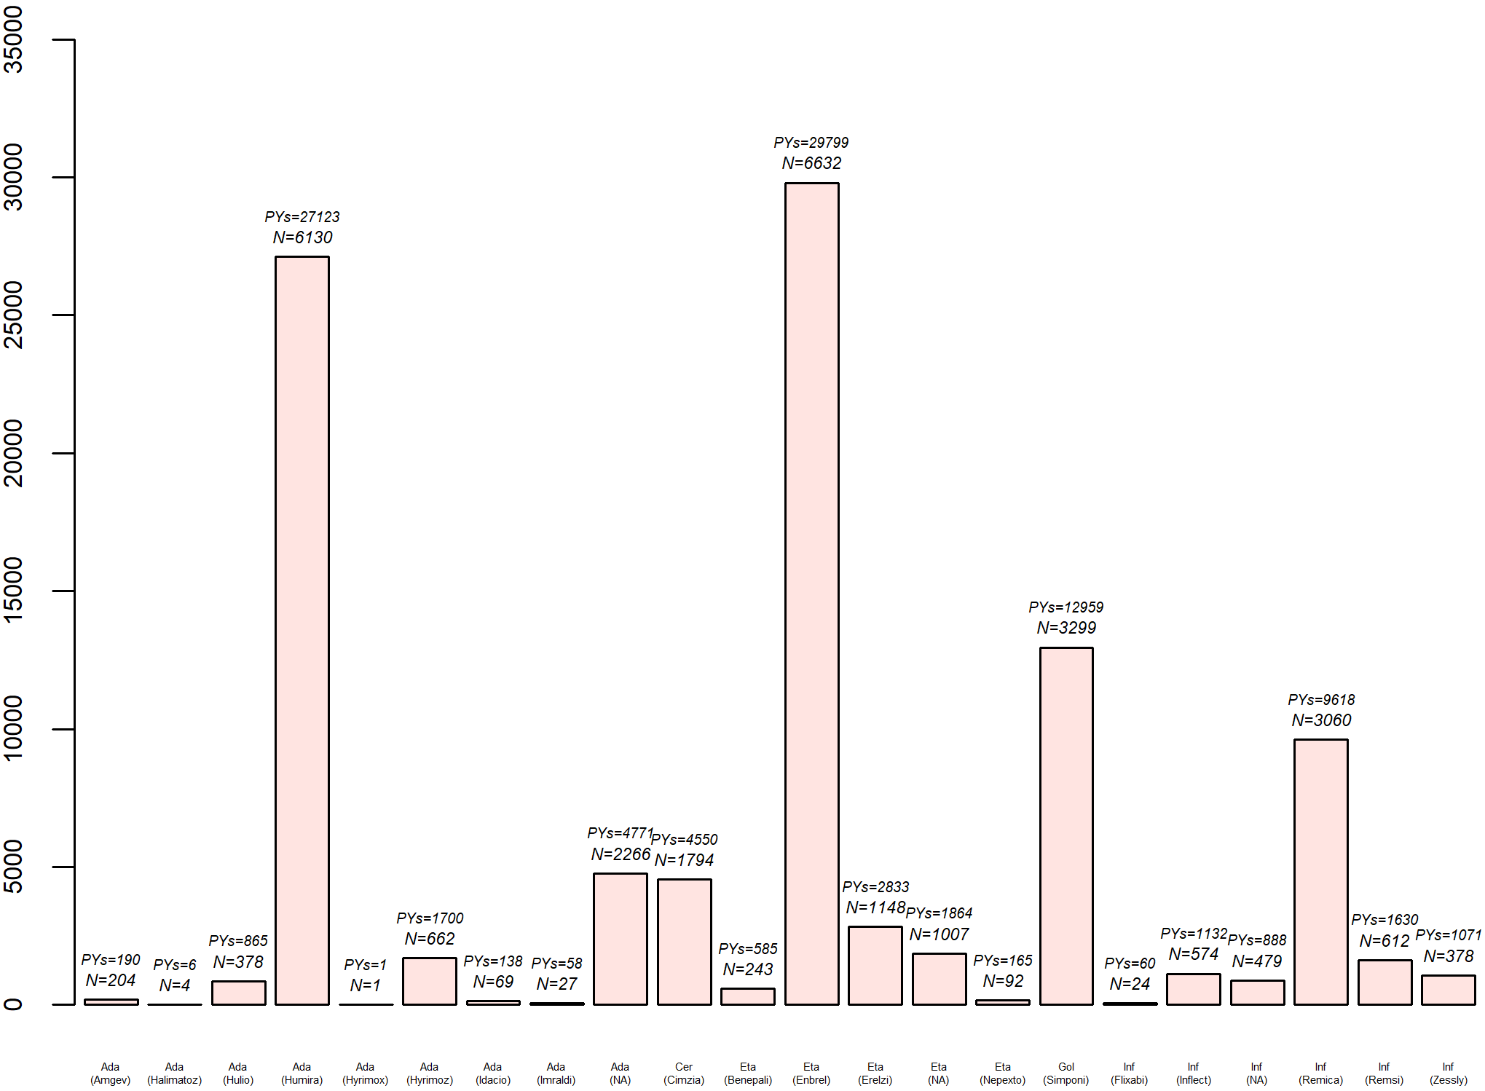
TNF-estäjien seurantatiedot vuoden 2025 loppuun
Ada – Adalimumab
Cer – Certolizumab pegol
Eta – Etanerecept
Gol – Golimumab
Inf – Infliximab

Slide 8
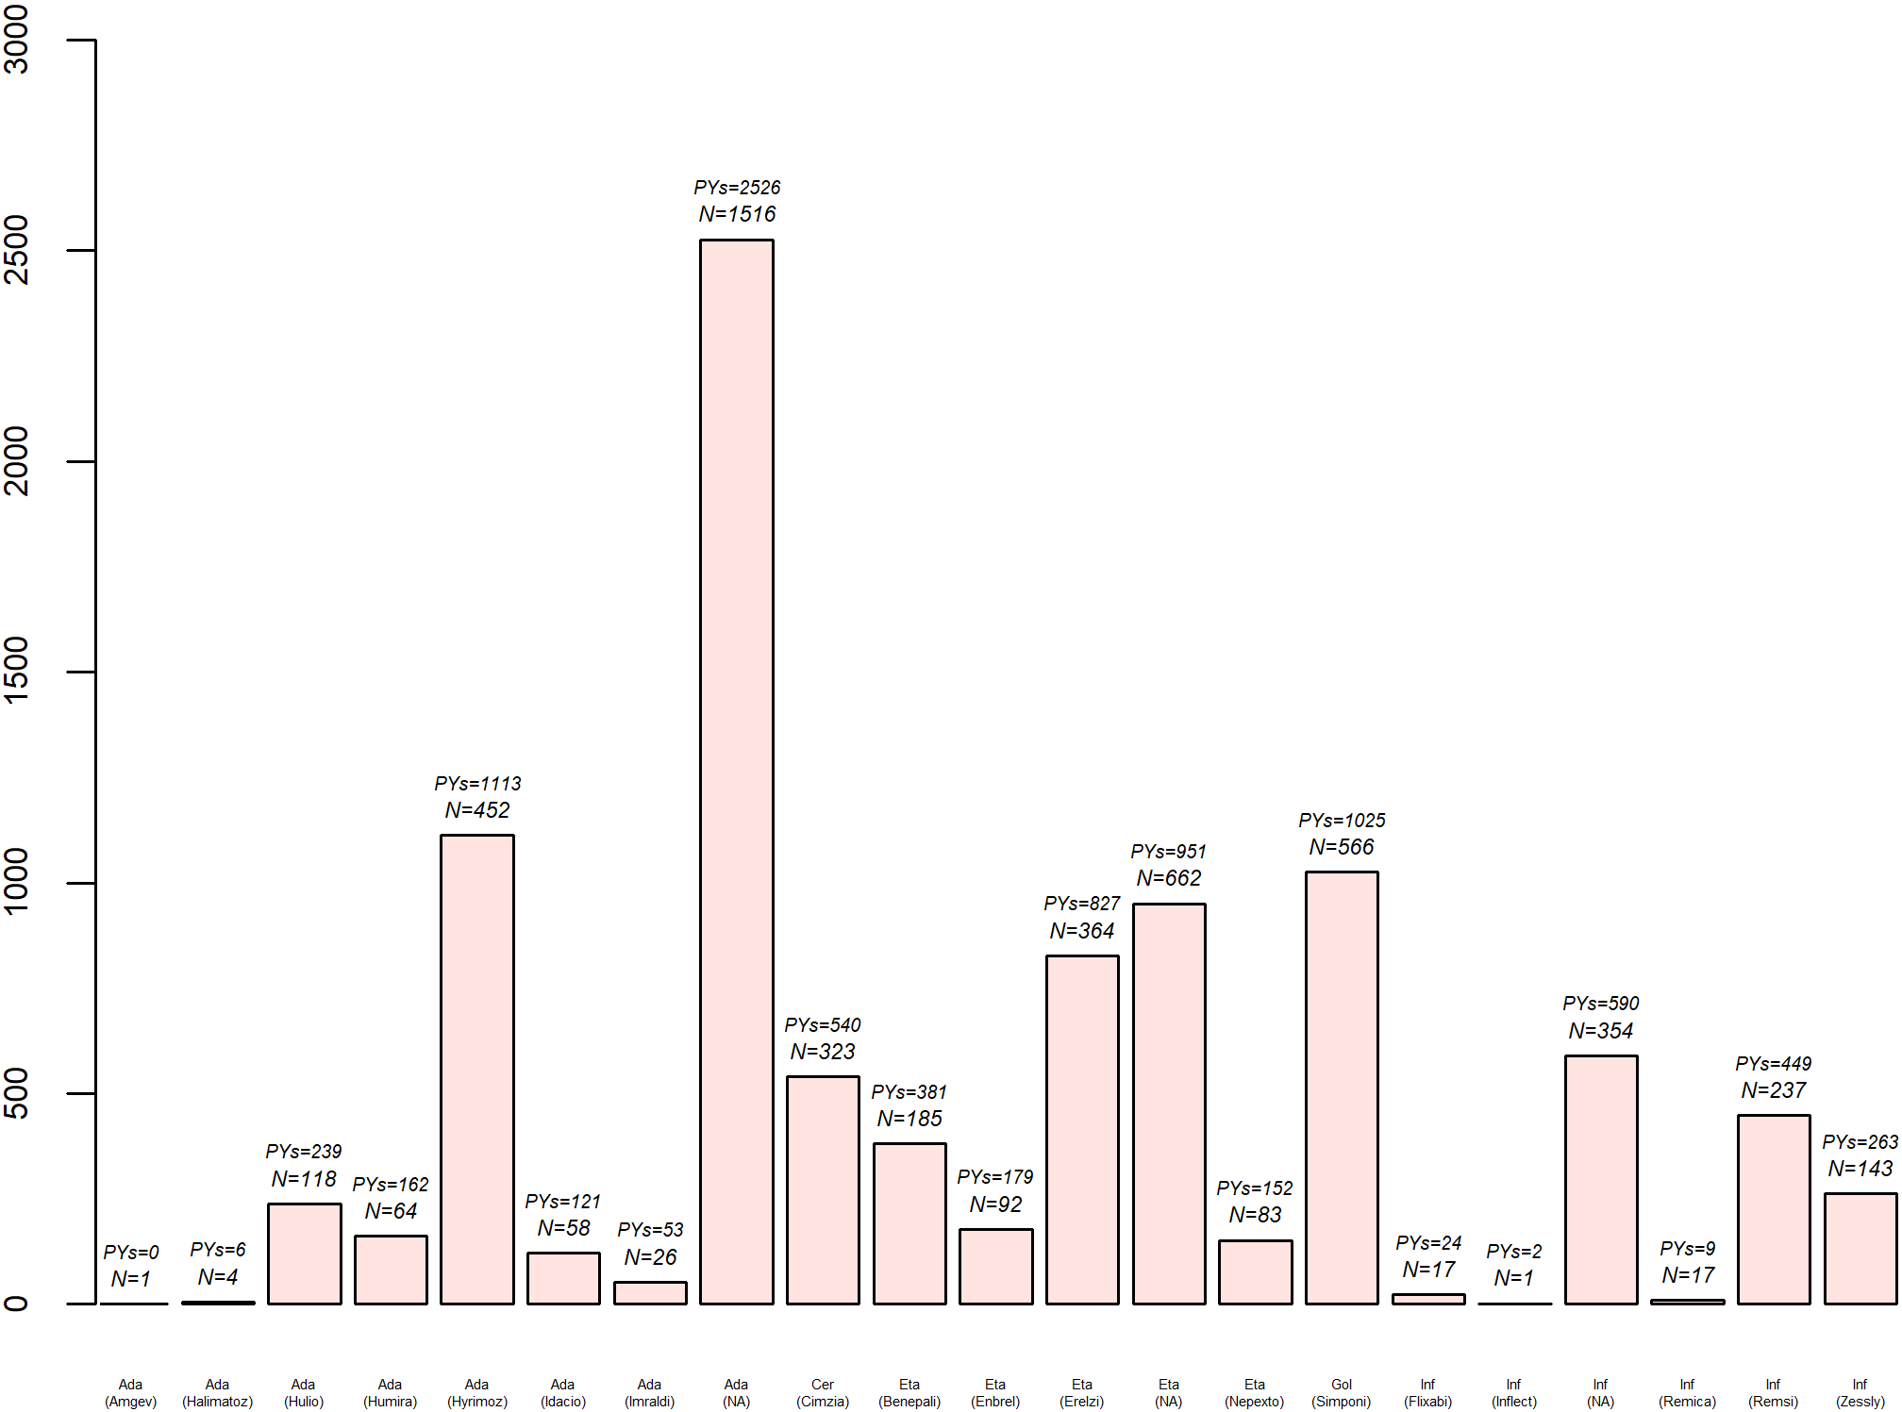
TNF-estäjien seurantatiedot, viimeiset 5 vuotta
Ada – Adalimumab
Cer – Certolizumab pegol
Eta – Etanerecept
Gol – Golimumab
Inf – Infliximab

Slide 9
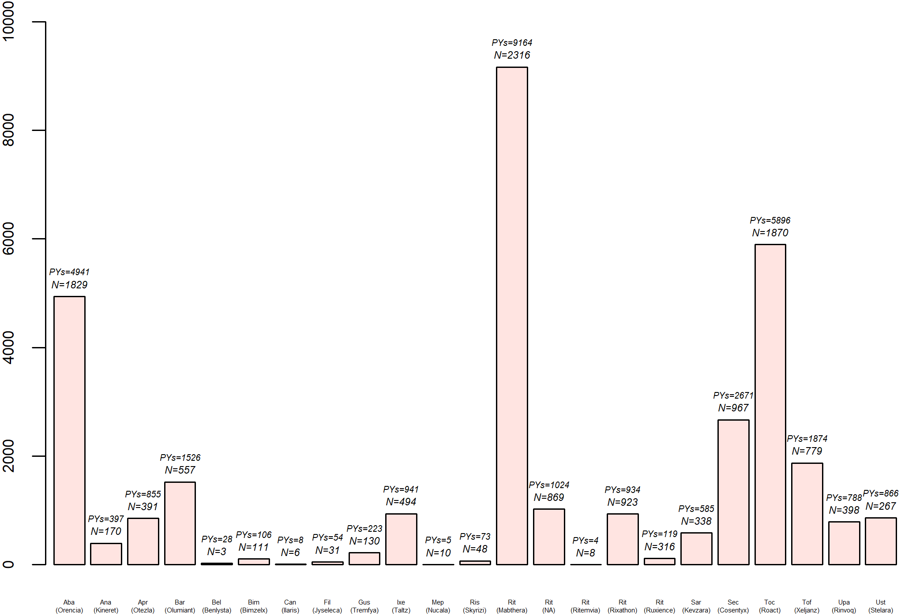
b/tsDMARD (ilman TNF-estäjiä) vuoden 2025 loppuun
Aba – Abatacept
Ana – Anakinra
Apr – Apremilast
Bar – Baricitinib
Bel – Belimumab
Bim – Bimekizumab
Can – Canakinumab
Fil – Filgotinib
Gus – Guselkumab
Ixe – Ixekizumab
Ris – Risankizumab
Mep - Mepolizumab
Rit – Rituximab
Sar – Sarilumab
Sec – Secukinumab
Toc – Tocilizumab
Tof – Tofacitinib
Upa – Upadacitinib
Ust - Ustekinumab

Slide 10
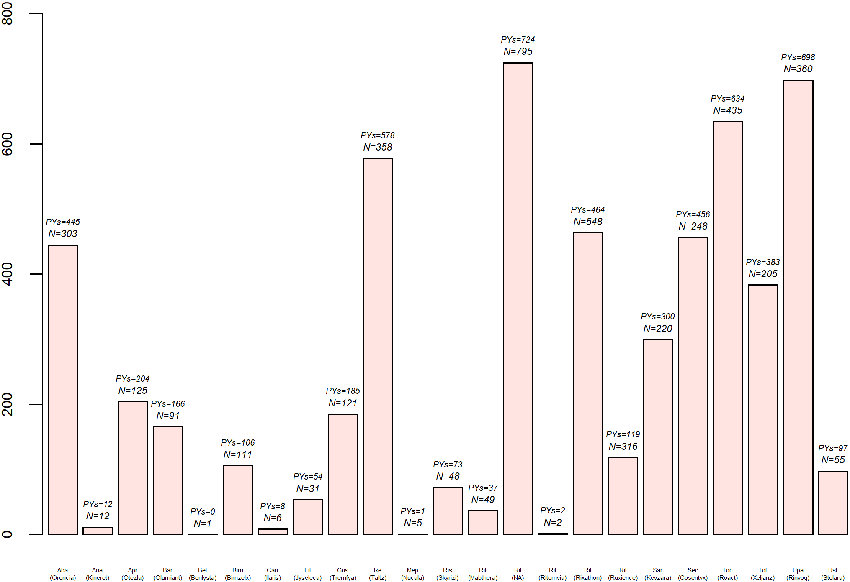
b/tsDMARD (ilman TNF-estäjiä), viimeiset 5 vuotta
Aba – Abatacept
Ana – Anakinra
Apr – Apremilast
Bar – Baricitinib
Bel – Belimumab
Bim – Bimekizumab
Can – Canakinumab
Fil – Filgotinib
Gus – Guselkumab
Ixe – Ixekizumab
Ris – Risankizumab
Mep - Mepolizumab
Rit – Rituximab
Sar – Sarilumab
Sec – Secukinumab
Toc – Tocilizumab
Tof – Tofacitinib
Upa – Upadacitinib
Ust - Ustekinumab

Slide 11
Rekisteriin 2025v osallistuneet sairaalat
Kainuun keskussairaala
Kanta-Hämeen keskussairaala
Keski-Suomen Sairaala Nova
Pohjois-Karjalan keskussairaala
Päijät-Hämeen keskussairaala
Satasairaala
Seinäjoen keskussairaala
Tampereen yliopistollinen sairaala

Slide 12
ROB-FIN ORIGINAALIJULKAISUT 2025
1) P. Hellamand, M. G.H. van de Sand, M. T. Nurmohamed, R. F. van Vollenhoven, R. J. Hollick, O. Rotariu, Z. Rotar, K. P. Pirkmajer, D. Nordström, A. Hokkanen, B. Michelsen, T. K. Kvien, B. Glintborg, A. G. Loft, K. Pavelka, J. Zavada, I. Castrejon, L. Otero-Varela, B. Gudbjornsson, O. Palsson, M. Østergaard, M. L. Hetland, T. Olofsson, J. K. Wallman, A. Ciurea, M. J. Nissen, T. D. Yıldırım, F. Onen, C. Codreanu, C. Mogosan, M. J. Santos, E. Vieira-Sousa, L. M. Ørnbjerg, J.W.R. Twisk, I. E. van der Horst – Bruinsma. Sex differences in patient-reported outcomes in association with clinical factors in axial spondyloarthritis patients treated with tumor necrosis factor inhibitors: findings from a multinational observational cohort study. Rheumatology, Apr 1;64(4):1853-1863, 2025
2) Romain Aymon, Denis Mongin,Romain Guemara, Zubeyir Salis,Johan Askling, Denis Choquette, Catalin Codreanu,Daniela Di Giuseppe, Irini Flouri ,Doreen Huschek, Kimme L. Hyrich, Florenzo Iannone, Tore K. Kvien, Burkhard F. Leeb, Dan Nordström, Lucia Otero-Varela, Karel Pavelka, Manuel Pombo-Suarez Ana Rodrigues, Ziga Rotar, Prodromos Sidiropoulos ,Sella A. Provan,Anja Strangfeld, Trokovic Nina,Jakub Zavada, Lianne Kearsley-Fleet,Delphine Courvoisier, Axel Finckh, Kim Lauper. Incidence of major adverse cardiovascular events in patients with rheumatoid arthritis treated with JAK-inhibitors compared to bDMARDs: data from an international collaboration of registries (the "JAK-pot" study). Arthritis&Rheumatology, 77:1194-1204, 2025.
3) Marion Pons, Stylianos Georgiadis, Mikkel Østergaard, Zohra Faizy Ahmadzay, Bente Glintborg, Jette Heberg, Sara Nysom Christensen, Simon Rasmussen, Anne Gitte Loft, Isabel Castrejón, Fernando Sánchez-Alonsoz, Florenzo Iannone, Antonio Carletto, Dan Nordström, Anna-Mari Hokkanen, Adrian Ciurea, Michael J. Nissen, Jakub Závada, Karel Pavelka, Ziga Rotar, Katja Perdan Pirkmajer, Brigitte Michelsen, Pawel Mielnik, Miguel Bernardes, Nikita Khmelinskii, Karin Laas, Sigrid Vorobjov, Catalin Codreanu, Corina Mogosan, Gary J. Macfarlane, Gareth T. Jones, Bjorn Gudbjornsson2, Olafur Palsson Johan K Wallman, Irene van der Horst-Bruinsma Fatos Onen, Merete Lund Hetland, Lykke Midtbøll Ørnbjerg. Four-year secukinumab treatment outcomes in European real-world axial spondyloarthritis and psoriatic arthritis patients. J Bone Spine, May;92(3):105824,2025.
4) Jacob B Jørgensen, Karl Bang Christensen, Brigitte Michelsen, Anne Gitte Loft, Simon Rasmussen, Jette Heberg, Merete Lund Hetland, Jakub Závada6 Karel Pavelka, Florenzo Iannone, Fabrizio Conti, Patrícia Nero, Joana Borges, Catalin Codreanu, Corina Mogosan, Bente Glintborg, Adrian Ciurea, Michael Nissen, Dan Nordström, Laura Kuusalo, Karin Laas, Sigrid Vorobjov, Bjorn Gudbjornsson, Thorvardur Jon Love, Mikkel Østergaard, Lykke Midtbøll Ørnbjerg. Asessing construct validity of DAPSA and DAPSA28 in PsA: an European observational study. RMD Open, Dec 23;11(4):e006104, 2025.
5) Liisa Ukkola-Vuoti, Anton Klavus, Toppila and Dan Nordström. Burden of disease and therapy patterns for psoriatic arthritis in Finland: a nationwide real-world evidence study. Scand J Rheumatol. Journal ISSN: 1502-7732, 2025.
6) Christos Polysopoulos , Stylianos Georgiadis , Lykke Midtbøll Ørnbjerg , Almut Scherer , Daniela Di Giuseppe , Merete Lund Hetland , Michael John Nissen , Gareth T Jones , Bente Glintborg , Anne Gitte Loft , Johan Karlsson Wallman , Karel Pavelka 9, Jakub Závada , Ayten Yazici, Maria José Santos , Adrian Ciurea , Burkhard Möller , Brigitte Michelsen, Pawel Mielnik, Johanna Huhtakangas, Heikki Relas, Katja Perdan Pirkmajer, Ziga Rotar, Ross MacDonald, Bjorn Gudbjornsson, Irene van der Horst-Bruinsma, Marleen van de Sande, Myriam Riek. Handling of missing component information for common composite score outcomes used in axial spondyloarthritis research when complete-case analysis is unbiased .BMC Med Res Methodol. Feb 28;25:55, 2025.
7) J. B. Jørgensen, K. B. Christensen, B. Michelsen, A. G. Loft, S. Horskjær Rasmussen, J. Heberg, M. L. Hetland, J. Zavada, K. Pavelka, F. Iannone, F. Conti, J. Borges, C. Codreanu, C. Mogosan, B. Glintborg, A. Ciurea, M. J. Nissen, D. Nordström, L. Kuusalo, & K. Laas, & 5 andra. Assessing internal construct validity of DAPSA and DAPSA28 in psoriatic arthritis: a European observational study using confirmatory factor analysis and additional psychometric testing, Dec 1; RMD open. 11, 4, 10 s., 2025

Slide 13
ROB-FIN ORIGINAALIJULKAISUT 2024
8) Linde L, Georgiadis S, Ørnbjerg LM, Rasmussen SH, Michelsen B, Askling J, Di Giuseppe D, Wallman JK, Závada J, Pavelka K, Bernardes M, Matos CO, Glintborg B, Loft AG, Nordström D, Kuusalo L, Möller B, Nissen MJ, Codreanu C, Mogosan C, et al. Comparing DAPSA, DAPSA28, and DAS28-CRP in Patients With Psoriatic Arthritis Initiating a First Tumor Necrosis Factor Inhibitor Across Nine European Countries. Arthritis Care Res. 76(11):1558–1565, 2024
9) Georgiadis S, Ørnbjerg LM, Michelsen B, Kvien TK, Di Giuseppe D, Wallman JK, Závada J, Provan SA, Kristianslund EK, Rodrigues AM, Santos MJ, Rotar Ž, Pirkmajer KP, Nordström D, Macfarlane GJ, Jones GT, van der Horst-Bruinsma I, Hellamand P, Østergaard M, Hetland ML. Cut-Offs for Disease Activity States in Axial Spondyloarthritis With ASDAS Based on CRP and ESR: Are They Interchangeable? J Rheumatol. 51(7):673–677, 2024
10) Ørnbjerg LM, Brahe CH, Linde L, Jacobsson L, Nissen MJ, Kristianslund EK, Santos MJ, Nordström D, Rotar Z, Gudbjornsson B, Onen F, Codreanu C, Lindström U, Möller B, Kvien TK, Barcelos A, Eklund KK, Tomšič M, Love TJ, Can G, et al. Drug effectiveness of 2nd and 3rd TNF inhibitors in psoriatic arthritis – relationship with the reason for withdrawal from the previous treatment. Joint Bone Spine. 91(4):105729, 2024
11) Aymon R, Mongin D, Bergstra SA, Choquette D, Codreanu C, De Cock D, Dreyer L, Elkayam O, Huschek D, Hyrich KL, Iannone F, Inanc N, Kearsley-Fleet L, Koca SS, Kvien TK, Leeb BF, Lukina G, Nordström DC, Pavelka K, Pombo-Suarez M, et al. Evaluation of discontinuation for adverse events of JAK inhibitors and bDMARDs in an international collaboration of rheumatoid arthritis registers (the 'JAK-pot' study). Ann Rheum Dis. 83(4):421–428, 2024
12) Ørnbjerg LM, Georgiadis S, Kvien TK, Michelsen B, Rasmussen S, Pavelka K, Závada J, Loft AG, Kenar G, Solmaz D, Glintborg B, Rodrigues A, Santos MJ, Di Giuseppe D, Wallman JK, Ciurea A, Nissen MJ, Rotar Z, Pirkmajer KP, Nordström D, et al. Impact of patient characteristics on ASDAS disease activity state cut-offs in axial spondyloarthritis: results from nine European rheumatology registries. RMD Open. 10(4), 2024
13) Lauper K, Mongin D, Bergstra SA, Choquette D, Codreanu C, Gottenberg JE, Kubo S, Hetland ML, Iannone F, Kristianslund EK, Kvien TK, Lukina G, Mariette X, Nordström DC, Pavelka K, Pombo-Suarez M, Rotar Z, Santos MJ, Tanaka Y, Turesson C, et al. Oral glucocorticoid use in patients with rheumatoid arthritis initiating TNF-inhibitors, tocilizumab or abatacept: Results from the international TOCERRA and PANABA observational collaborative studies. Joint Bone Spine. 91(2):105671 , 2024
14) Christiansen SN, Horskjær Rasmussen S, Pons M, Michelsen B, Glintborg B, Gudbjornsson B, Grondal G, Vencovsky J, Loft AG, Rotar Z, Pirkmajer KP, Nissen MJ, Baranová J, Macfarlane GJ, Jones GT, Iannone F, Caporali R, Laas K, Vorobjov S, Di Giuseppe D, et al. Patient-reported outcomes in axial spondyloarthritis and psoriatic arthritis patients treated with secukinumab for 24 months in daily clinical practice. Semin Arthritis Rheum. 65:152388, 2024
15) Linde L, Ørnbjerg LM, Georgiadis S, Rasmussen SH, Lindström U, Askling J, Michelsen B, Di Giuseppe D, Wallman JK, Gudbjornsson B, Love TJ, Nordström DC, Yli-Kerttula T, Nekvindová L, Vencovský J, Iannone F, Cauli A, Loft AG, Glintborg B, Laas K, et al. Predictors of DAPSA28 remission in patients with psoriatic arthritis initiating a first TNF inhibitor: results from 13 European registries. Rheumatology (Oxford). 63(3):751–764, 2024
16) Ahmadzay ZF, Heberg J, Jorgensen JB, Ørnbjerg LM, Ostergaard M, Moller-Bisgaard S, Michelsen B, Loft AG, Jones GT, Hellamand P, Scherer A, Nissen MJ, Pavelka K, Závada J, Laas K, Vorobjov S, Nordström D, Sokka-Isler T, Regierer AC, Reich A, et al. Recording of non-musculoskeletal manifestations, comorbidities and safety outcomes in European spondyloarthritis registries: a survey. Rheumatol Adv Pract. 8(4):rkae135, 2024
17) Hellamand P, van de Sande MGH, Nurmohamed MT, van Vollenhoven RF, Hollick RJ, Rotariu O, Rotar Z, Pirkmajer KP, Nordström D, Hokkanen AM, Michelsen B, Kvien TK, Glintborg B, Hetland ML, Østergaard M, Loft AG, Pavelka K, Závada J, Castrejon I, Otero-Varela L, et al. Sex differences in patient-reported outcome measures and the association with clinical factors in axial spondyloarthritis patients treated with tumour necrosis factor inhibitors. Rheumatology (Oxford). 64(4):1853–1863 , 2024
18) Kauppi I, Valkokari V, Muilu P, Helminen M, Salo H, Nordström D, Rantalaiho V, Isomäki P. Yhdistelmähoito yleisin tuoreeseen nivelreumaan – tulokset hyviä. Suomen Lääkärilehti. 79(45–46), 2024

Slide 14
ROB-FIN ORIGINAALIJULKAISUT 2023
19) Pombo-Suarez M, Sanchez-Piedra C, Gomez-Reino J, Lauper K, Mongin D, Iannone F, Pavelka K, Nordström DC, Inanc N, Codreanu C, Hyrich KL, Choquette D, Strangfeld A, Leeb BF, Rotar Z, Rodrigues A, Kristianslund EK, Kvien TK, Elkayam O, Lukina G, et al. After JAK inhibitor failure: to cycle or to switch, that is the question – data from the JAK-pot collaboration of registries. Ann Rheum Dis. 82(2):175–181, 2023
20) Linde L, Ørnbjerg LM, Rasmussen SH, Love TJ, Loft AG, Závada J, Vencovsky J, Laas K, Nordström D, Sokka-Isler T, Gudbjornsson B, Grondal G, Iannone F, Ramonda R, Hellamand P, Kristianslund EK, Kvien TK, Rodrigues AM, Santos MJ, Codreanu C, et al. Commonalities and differences in set-up and data collection across European spondyloarthritis registries – results from the EuroSpA collaboration. Arthritis Res Ther. 2023;25(1):205, 2023
21) Michelsen B, Ostergaard M, Nissen MJ, Ciurea A, Möller B, Ørnbjerg LM, Závada J, Glintborg B, Macdonald A, Laas K, Nordström D, Gudbjornsson B, Iannone F, Hellamand P, Kvien TK, Rodrigues AM, Codreanu C, Rotar Z, Fernandez IC, Wallman JK, et al. Differences and similarities between the EULAR/ASAS-EULAR and national recommendations for treatment of patients with psoriatic arthritis and axial spondyloarthritis across Europe. Lancet Reg Health Eur. 33:100706 , 2023
22) Hokkanen AM, Aaltonen K, Relas H, Rutanen J, Kononoff A, Taimen K, Kauppi M, Puolakka K, Trokovic N, Nordström D. Impact of TNF inhibitor medication on working ability in axial spondyloarthritis: an observational national registry-based cohort study. Rheumatol Adv Pract. 7(2), 2023
23) Glintborg B, Di Giuseppe D, Wallman JK, Provan SA, Nordström D, Hokkanen AM, Österlund J, Kristianslund E, Kvien TK, Gudbjornsson B, Hetland ML, Michelsen B, Jacobsson L, Askling J, Lindström U. Is the risk of infection higher during treatment with secukinumab than with TNF inhibitors? An observational study from the Nordic countries. Rheumatology (Oxford). 62(2):647–658, 2023
24) Dominique A, Hetland ML, Finckh A, Gottenberg JE, Iannone F, Caporali R, Kou TD, Nordström D, Hernandez MV, Sanchez-Piedra C, Sanchez-Alonso F, Pavelka K, Bond TC, Simon TA. Safety outcomes in patients with rheumatoid arthritis treated with abatacept: results from a multinational surveillance study across seven European registries. Arthritis Res Ther. 25(1):101, 2023
25) Linde L, Ørnbjerg LM, Heegaard Brahe C, Wallman JK, Di Giuseppe D, Závada J, Castrejon I, Diaz-Gonzalez F, Rotar Z, Tomšič M, Glintborg B, Gudbjornsson B, Geirsson AJ, Michelsen B, Kristianslund EK, Santos MJ, Barcelos A, Nordström D, Eklund KK, Ciurea A, et al. Second and third TNF inhibitors in European patients with axial spondyloarthritis: effectiveness and impact of the reason for switching. Rheumatology (Oxford). 63(7):1882–1892, 2023
26) Hellamand P, van de Sande M, Ørnbjerg LM, Klausch T, Nurmohamed MT, van Vollenhoven RF, Nordström D, Hokkanen AM, Santos MJ, Vieira-Sousa E, Loft AG, Glintborg B, Hetland ML, Lindström U, Wallman JK, Michelsen B, Kristianslund EK, Ciurea A, Nissen MS, Codreanu C, et al. Sex differences in the effectiveness of first-line tumour necrosis factor inhibitors in axial spondyloarthritis: results from the EuroSpA Research Collaboration Network. RMD Open. 9(4) , 2023
27) Glintborg B, Di Giuseppe D, Wallman JK, Nordström DC, Gudbjornsson B, Hetland ML, Askling J, Grondal G, Sokka T, Provan SA, Michelsen B, Kristianslund EK, Dreyer L, Love TJ, Lindström U. Uptake and effectiveness of newer biologic and targeted synthetic disease-modifying antirheumatic drugs in psoriatic arthritis: results from five Nordic biologics registries. Ann Rheum Dis. 82(6):820–828, 2023

